Slide 1


cracking the mask
From “Advocating as Student” to “Advocating for Students” in my Early Career
OCUL Accessibility Symposium 2.0
June 17, 2025

Slide 2
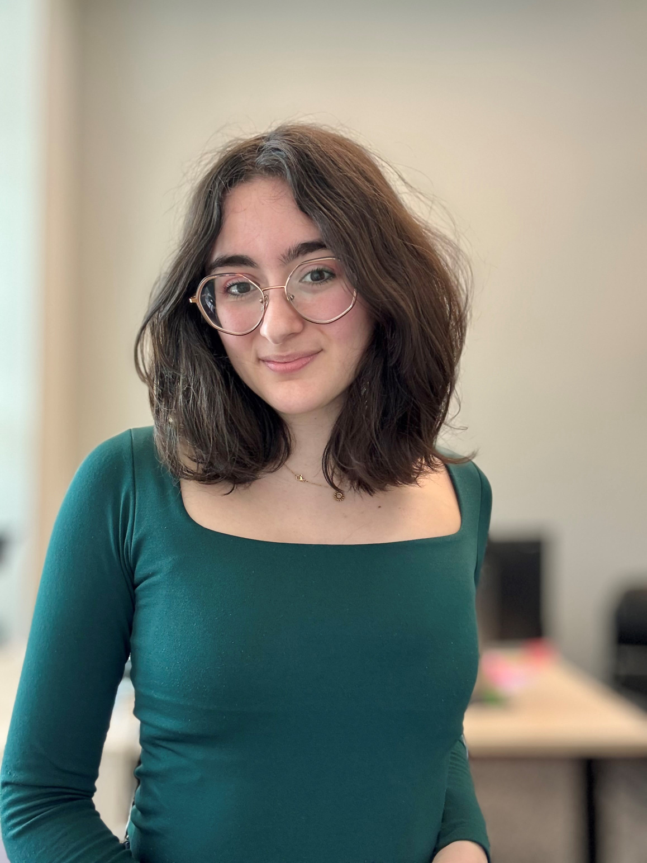
Emma Bullerwell
she/they
Former Library Accessibility Services Assistant, Queen’s University Library
BA in Music, Acadia University, 2022
Find me on LinkedIn

Slide 3

honouring place
emotionally
physically
positionally

Slide 4
honouring where we are
Kespukwitk and Sipekne’katik in Mi’kma’ki /
Yarmouth & Acadian Shores and
Annapolis Valley in Nova Scotia
Unceded territory of the Mi’kmaq peoples.

Slide 5
honouring where we have been
Katarokwi / Kingston, Ontario
Traditional territory of the Anishinabek, Haudenosaunee, and the Huron-Wendat peoples.

Slide 6
today’s topics
  What is the mask?
  Recipe for self-advocation
  How do we advocate for a culture of inclusion?
  How can we support a culture of inclusion?

Slide 7
the mask
“Masking” is the conscious or unconscious attempt to conceal neurodivergent traits.
This allows the neurodivergent individual to appear neurotypical.

Slide 8

recipe for self-advocation
Ingredients:
  confidence
  crack the mask
  communication

Slide 9
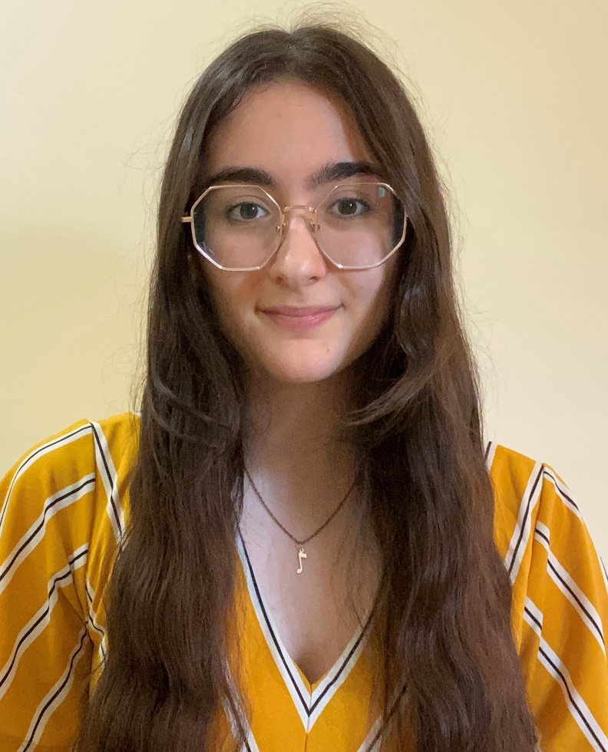

CONFIDENCE
Emma @ 22 years old
What does effective confidence look like?
  Acceptance
  Anti-ableist action
  Discovery
photo taken April 2022

Slide 10
CRACK THE MASK
What does effectively cracking the mask look like?
  Setting boundaries
  Finding language that you are comfortable with
  Dismantling shame around your disability

Slide 11
CRACK THE MASK: CONTINUED
“As a neurodivergent person, my daily life is affected by my disability. I believe people with disabilities should be in positions assisting those with accessibility needs, because we understand what it is like to ask for, fight for, and receive support.
Queen’s Library Accessibility Services Assistant Cover Letter, August 2022

Slide 12

COMMUNICATION
What does effective communication look like?
  Speaking your truth
  Standing up for yourself and others
  Making space for accommodation

Slide 13
how do we advocate for a culture of inclusion?
  Get LOUD
  Get CREATIVE
  LEAD by example
  DISCOVER what other institutions &
activists are doing

Slide 14
how do we support a culture of inclusion?
  CONSCIOUSLY work towards a culture of inclusion
  LISTEN carefully
  Allow for INNOVATIVE solutions
  REPLICATE best practices
  Regularly CONVERSE about inclusion

Slide 15
KEY TAKEAWAYS
  Masking is a survival tool, but so is advocacy.
  You do not have to disclose to be a good advocate.
  Confidence in advocacy improves confidence in self-advocacy, and vice-versa.
  Advocating for a culture of inclusion requires innovative action. Educate yourself and lead with best practices.
  Supporting a culture of inclusion requires a conscious effort, an open mind, and a willingness to change.
“nothing about us without us”

Slide 16
“I get by with a little help from my friends...”
A warmest “thank you” to those who have taken a chance on me and supported me throughout my career so far.

