Slide 1
From Concept to Creation: Developing an Open Access Resource for Accessible Library Teaching
Anna Flak, Katie Harding, Katie Merriman, Matt Fesnak, and Nancy Waite
McMaster University Libraries
OCUL Accessibility Symposium 2.0
June 19, 2025

Slide 2
Land Acknowledgement
McMaster University is located on the traditional territory of the Haudenosaunee and Anishinaabe nations. Many urban Indigenous folk also continue to inhabit Hamilton and its surrounding areas. This territory was the subject of the Dish with One Spoon Wampum Belt Covenant, an agreement between the Iroquois Confederacy and the Ojibwe and allied nations to peaceably share and care for the resources around the Great Lakes.
As we reflect on our presence here, as guests and uninvited settlers, we recognize that accessibility is a key component of justice and inclusion for all communities, including Indigenous peoples and those belonging to our institution.
Notes:
As we reflect on our presence here, we also recognize that accessibility is a key part of justice and inclusion for all communities, including Indigenous peoples

Slide 3
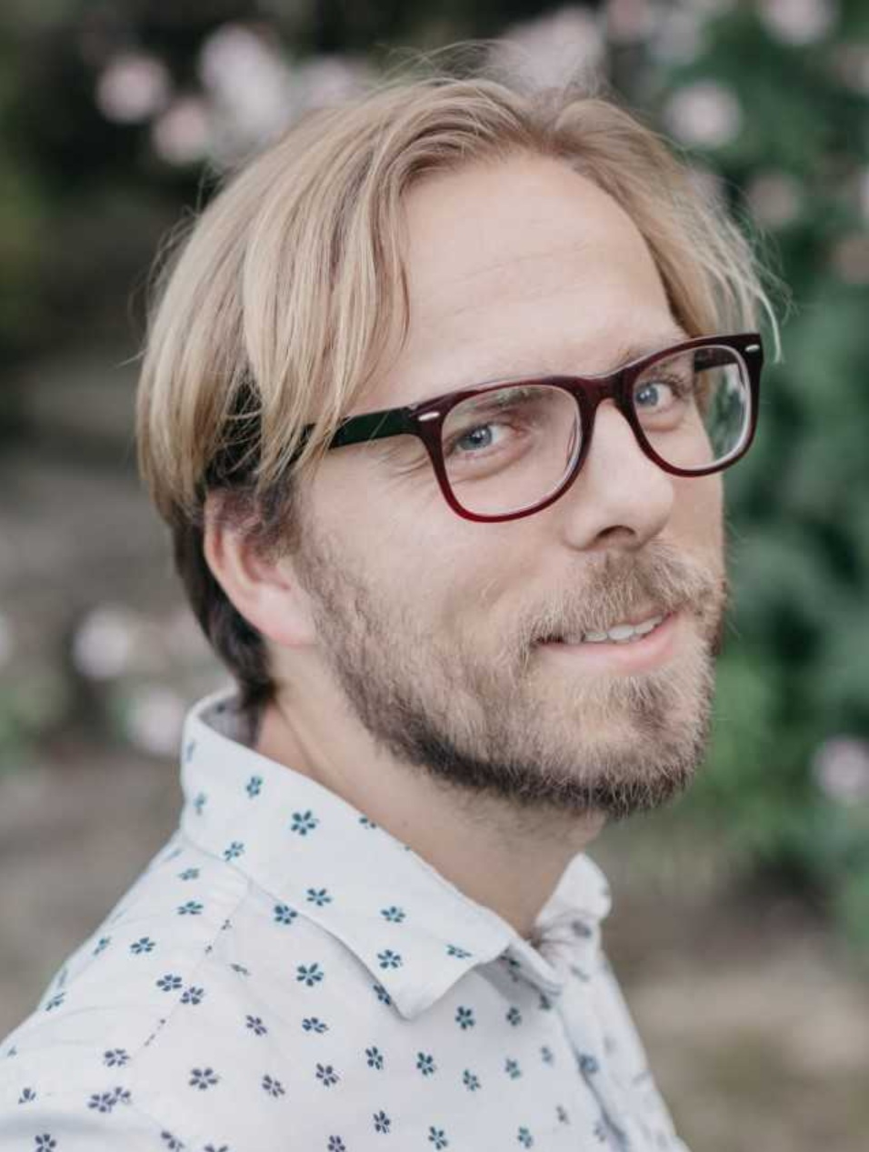
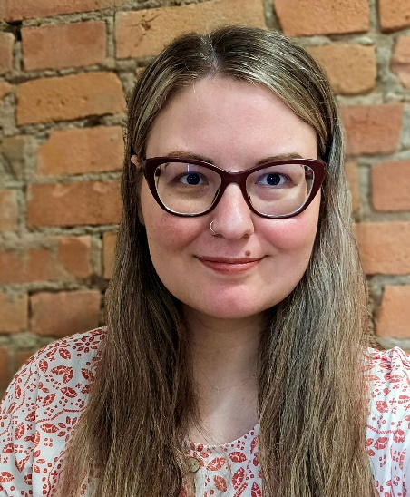
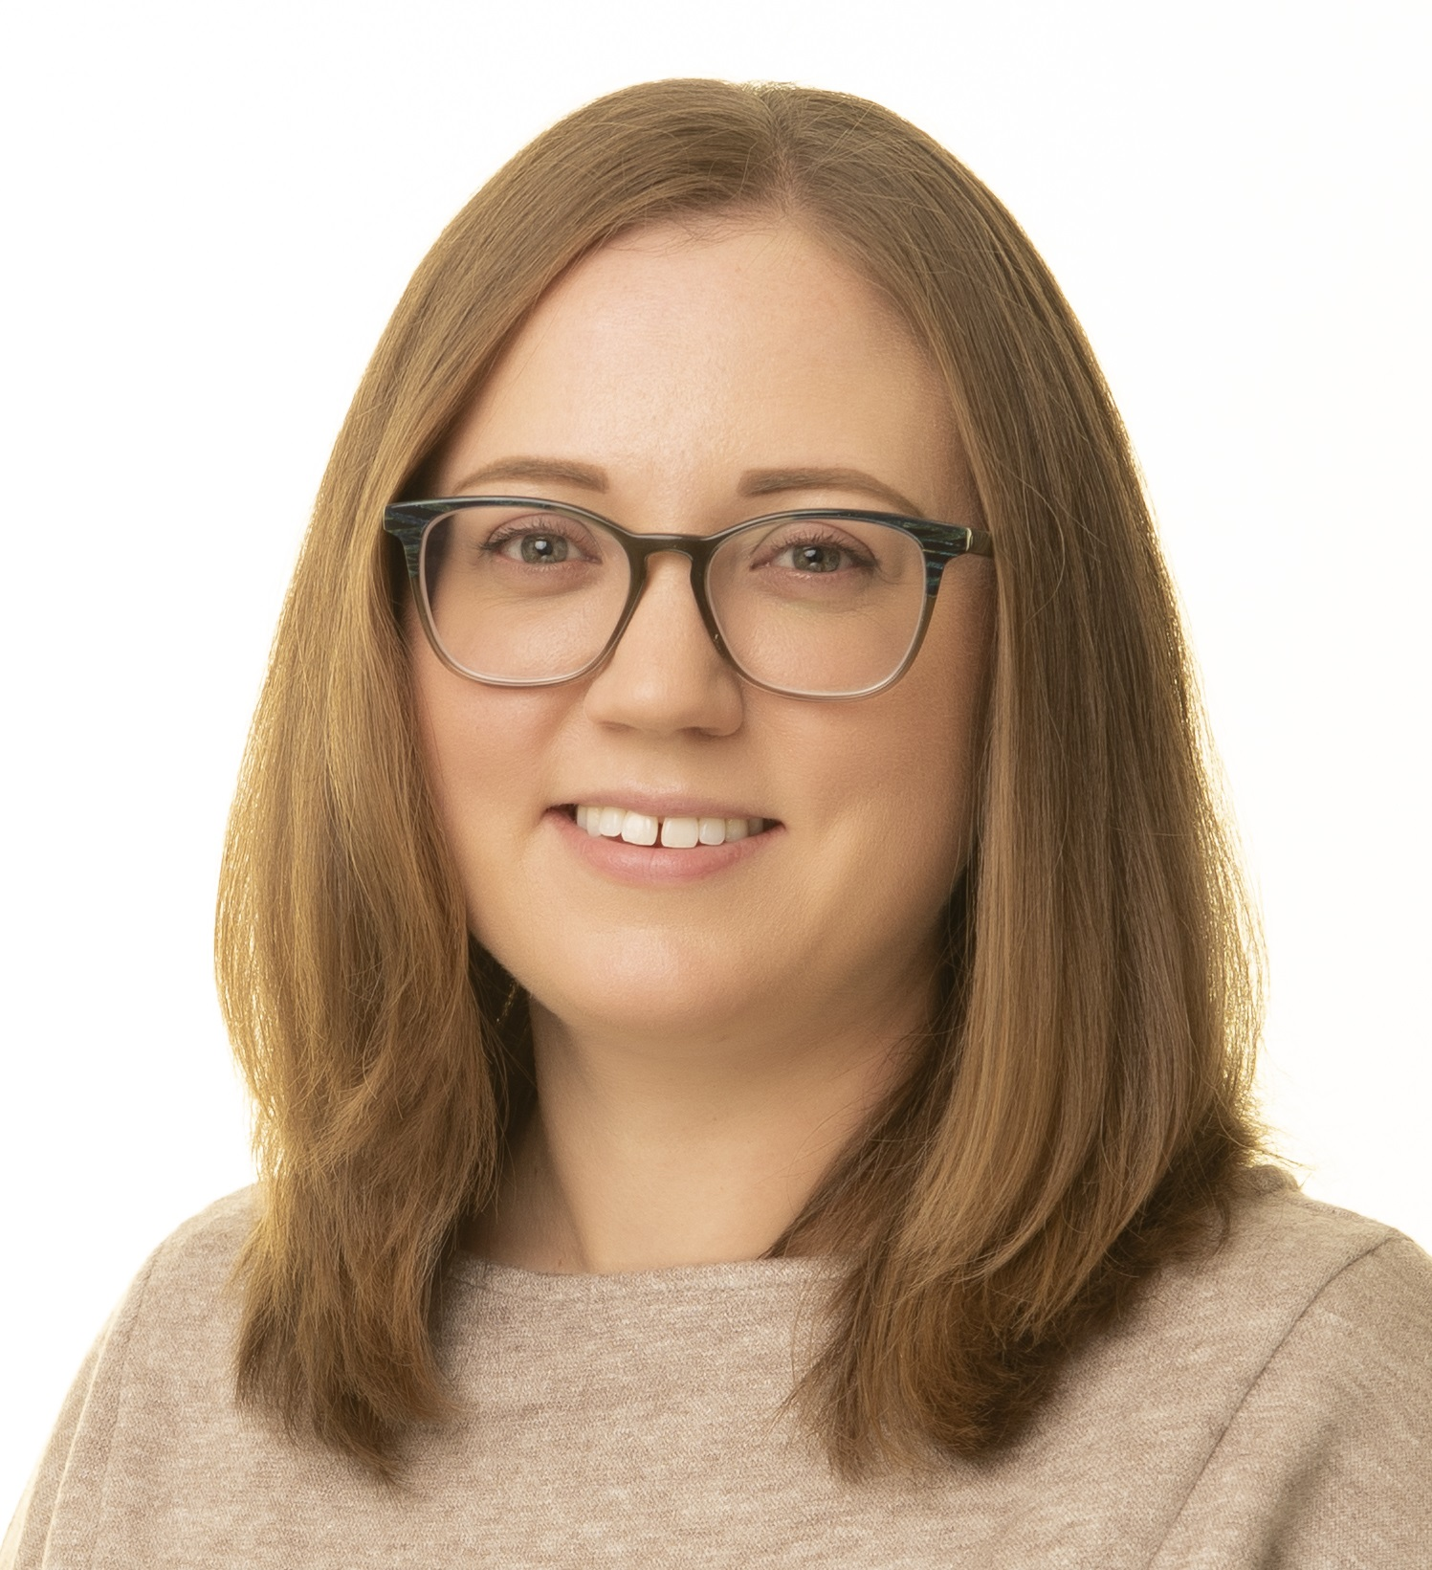
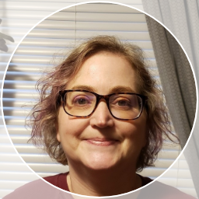
Introductions
Matt
Fesnak
Anna
Flak
Katie
Harding
Katie
Merriman
Nancy
Waite
Notes:
These are our panelists for this session, all of us work at the McMaster University Libraries.

Slide 4
Overview
Overview of the project
Presentations by chapter authors
Questions for panelists
Q&A

Slide 5
Background
Anna and Katie participated McMaster's inaugural Accessible Education Fellows program in 2023-2024
Our project focused on making screenshots and live demos more accessible in library instruction
We weren't finding much information about the library-specific ways that we teach and engage with students
We proposed a library strategic initiative for accessible library teaching
Notes:
We were interested in exploring accessibility in library settings
Information available about strategies for teaching in a course, but we teach in different ways in libraries and have different information available to us about our patrons.

Slide 6
Goals
Provide an opportunity for team members to take a "deep dive" into an accessibility topic.
Create a resource that can be used within our library to help make our library teaching practices more accessible.
Share our resource openly with library workers at other institutions.

Slide 7
Getting Started
Environmental scan for information about accessibility in library teaching and learning practices
Call for collaborators from within McMaster University Libraries
Created chapter guidelines and project timeline
Shared examples of open resources about accessibility topics

Slide 8
Team Members
Teaching & Learning: Jeannie An, Anna Flak, Katie Harding, Carly McLeod, Katie Merriman, Ariel Stables-Kennedy
Health Sciences Library: Laura Banfield, Louise Caravaggio, Susanna Galbraith, Jo-Anne Petropoulos
Distinctive, Legacy, and Digital Heritage Collections: Matthew Fesnak
Digital Scholarship Services: Subhanya Sivajothy
Library Accessibility Services: Nancy Waite
Notes:
Our project included 13 people from different departments in McMaster University Libraries. We had a lot of representation from our Teaching & Learning team and from the Health Sciences Library, as well as folks from Distinctive, Legacy, and Digital Heritage Collections, Digital Scholarship Services, and Library Accessibility Services.

Slide 9
Chapter Guidelines
Simple chapter template
Overview
Description of library teaching practice
Guiding principles
Recommendations for accessibility
References
Further reading and resources
Tone: More practical than scholarly
Flexibility
Notes:
Chapter template:
Overview: A one-paragraph description of the chapter.
Description of library teaching practice: Describe the library teaching practice and any ways in which common approaches may present barriers or be inaccessible.
Guiding principles: Describe any guiding principles or frameworks informing your recommendations.
Recommendations for accessibility: Provide recommendations for how to make the teaching practice and learning experience accessible to a wide range of learners with different needs and preferences. You can include openly licensed content published elsewhere.
References: List of sources in APA format.
Further reading and resources: List of any additional resources that readers might consult to learn more.

Slide 10
Chapter Topics
Authors identified 8 areas of interest:
Online and in-person instruction
Instructional workshops
Accessible technology in teaching
Research consultations
LibGuides
Online learning objects
Access services
Outreach events
Notes:
We worked with authors to determine chapter topics. We wanted them to be able to choose something that would be relevant to their work.

Slide 11
Writing and Revising
Meetings for discussion, questions, scheduled work time
Peer review process
Authors peer reviewed other chapters from the project
Additional reviewers from McMaster University Libraries, McMaster's Accessibility Community of Practice, McMaster Student and Alumni Accessibility Council
Revisions
Editorial review

Slide 12
Open Publishing
Published 8 chapters in Pressbooks
Licensed CC BY to encourage sharing and reuse
Now available: Accessible Library Teaching
Notes:
Description of image: Cover of our book which shows an arc of a gold circle over a maroon background with the title "Accessible Library Teaching".

Slide 13
Presentations by Chapter Authors

Slide 14
Integrating Accessible Technology into Teaching
Nancy Waite, Coordinator, Library Accessibility Services
Notes:
Hi, my name is Nancy Waite, I am the Coordinator for Library Accessibility Services. A position I have held for 13 years.

Slide 15
Chapter Overview – Integrating Accessible Technology into Teaching
Examines common assistive technology (AT)
Student specific technology (screen readers, mobility devices, assistive listening systems)
Class-wide technology (captions, described video and accessible learning resources)
Best practices to enhance accessibility
Notes:
This chapter explores assistive technology (AT) that instructors are most likely to encounter in the classroom. It’s organized into two main themes: the first focuses on student-specific technologies, such as screen readers, mobility devices, and assistive listening systems. The second highlights classwide tools that can benefit all learners, including captions, described video, and accessible digital resources. Throughout the chapter, best practices are shared to help ensure students are effectively and equitably supported in their learning environments.

Slide 16
Selecting Technology
Students
Best resource
Expert at what works for their needs
VPAT (Voluntary Product Accessibility Testing)
Provides accessibility information, though reliability varies based on authorship and date of completion.
Notes:
"When it comes to choosing technology for your classroom, your best resource is your students. They’re the ones using the tools—and in many ways, they’re the real subject matter experts. Ask them what works for them and what doesn’t.
Now, if you’re choosing technology that isn’t tied to a specific student—maybe something for the whole class—it’s a good idea to check the product’s VPAT. That stands for Voluntary Product Accessibility Template.
A VPAT gives you an idea of how accessible a product is, but they aren’t perfect. One issue is that many VPATs are completed by the company that made the product. So, the first thing you want to look at is: who completed the VPAT? Was it the developer or a third party? And how old is the document? That information should be one of the first things you encounter in the document.
Once you’ve checked that, you can actually learn a fair bit about the product’s accessibility features—or where it may fall short.
And finally, I’ll go back to where we started: your students. Whenever possible, have students test out the product. Let them try it in the context of what you need it to do. Their feedback is the best way to figure out if it’s really going to work for your class.

Slide 17
Student Specific Assistive Technology
Screen Readers – JAWS, VoiceOver, NVDA
Separate program-like JAWS or NVDA or
Built in OS based tool such as VoiceOver.
Provide class materials in a well formatted Word document.
Assistive Listening System (ALS)
Wireless hearing system
Use the microphone
Notes:
Let’s start with technology that’s often specific to individual students—screen readers.
Some of the most common screen readers include JAWS, VoiceOver, and NVDA. Originally, screen readers like JAWS had to be purchased separately, but now most operating systems come with built-in options. For example, Mac has VoiceOver and Windows has Narrator.
To best support students who use screen readers, I recommend providing accessible Word documents whenever possible.
While it’s true that screen readers can read PDFs, in my experience, PDFs often introduce too many issues—things like improperly tagged content, inconsistent reading order, or images without alt-text.
Word documents are typically more reliable and easier to navigate with assistive tech, especially if proper heading styles and structure are used."
"Next is Assistive Listening Systems, or ALS.
These are wireless hearing systems built right into many lecture halls and auditoriums.
As an instructor, your role is to make sure you’re broadcasting on the correct audio channel so the student can receive the sound clearly through their device. This channel info will usually be posted in the classroom, or available in a centralized room listing.
To get the best results, always use the audio equipment provided—usually a microphone—and make sure it’s positioned well to avoid any interference from things like clothing or facial hair.
Also, if a student or guest is asking a question, make sure they use the microphone too. If that’s not possible, be sure to repeat the question before answering so that the student using ALS has full access to what’s being said."

Slide 18
Student Specific AT – pg. 2
Mobility Devices
Consult with students about seating preferences
Respect mobility devices as an extension of personal space.
Speech to Text – Dragon Naturally Speaking, Dictate, etc.
No direct assistance needed
Instructors should be aware that spelling, grammar and punctuation may not be perfect.
Notes:
"When it comes to mobility devices, it’s important to start by checking in with the student about their seating preferences.
Don’t assume they want to sit in the front row—or anywhere specific, for that matter. Some might prefer the back or a spot near the door. The key is to ask, and then make sure a seat is reserved for them wherever they’d like to be.
Also, be mindful that mobility devices—like wheelchairs or walkers—are considered part of the person’s personal space. Unless a student asks you to help, never move their device.
If the class is being relocated for any reason, try to notify students as soon as possible. And make sure they know where key locations are, like the nearest accessible washroom, cafeteria, and elevator.
Finally, encourage students to sign up for campus facility alerts so they get notified if there are any planned or emergency closures that could affect their route or access."
Next up is speech-to-text technology—things like Dragon NaturallySpeaking or Microsoft Dictate.
Generally, instructors don’t need to provide direct support for these tools, but there are a few things to be aware of.
When students are first learning to use speech-to-text software, or when they’re using a brand-new device, the software may still be learning their voice patterns.
That means spelling, grammar, and punctuation might not be perfect right away. As the program becomes more trained, the accuracy usually improves significantly—so a little patience and understanding goes a long way."

Slide 19
Class-wide Assistive Technology
Closed captions
Essential for D/deaf and hard of hearing students
Required by AODA for all supplementary classroom content
Live Captions
Use provided microphone and audio equipment for both instructor and anyone speaking in class.
Stable internet is required.
Notes:
"Now let’s turn to classwide assistive technology—and one of the most impactful tools you can use is closed captions.
While captions are essential for students who are D/deaf or hard of hearing, they also support a wide range of learners. That includes students with auditory processing disorders, students learning English as a second language, and even students watching videos in noisy environments—like on the bus.
And to put it in perspective, 70% of Gen Z actually prefer watching videos with captions.
Under AODA, and most other accessibility legislation, captions are required on all videos shown in class.
Now, while automatic speech recognition—ASR—has come a long way since I started working in accessibility, we still can’t assume it gets everything right. Always double-check your captions. Fix any mistakes, or send the video to a third-party captioning service if needed.
In addition to pre-recorded videos, there’s also the option of live captions. These are generated in real time, either by a human captioner or through speech-to-text tools, and are great for lectures and live events.
But for live captions to work properly, the audio needs to go through the correct audio equipment. That means anyone speaking must use the microphone—and make sure it’s positioned correctly.
Also, because live captioners typically connect over the internet, having a stable connection is absolutely essential for real-time accuracy."

Slide 20
Class-wide AT – pg. 2
Described Video / Audio Description (DV/AD)
Created when key visuals are not conveyed through audio
Standard: Same length as the original film
Extended: Film is paused to insert detailed descriptions
Learning Management Systems (LMS)
Use built-in accessibility checkers
Create content directly in the LMS
Use proper headings, rather than bolding text.
Notes:
Continuing the conversation about classwide assistive technology, our next topic is Described Video.
Now, DV is often provided as a student-specific accommodation, but if the entire class is watching a movie, it’s more inclusive to show the Described Video version to everyone. That’s why I’ve included it in the classwide section of this presentation.
Because of cost, DV is generally only created when essential visual content is missing from the audio. So, if you're watching a film that’s just someone speaking—what I call a 'talking head'—then DV usually isn’t necessary.
However, when visuals are important to understanding the film, DV becomes essential for students who are blind or visually impaired, or who can’t interpret visual content.
There are two types of Described Video. The first is standard, where short descriptions are added into natural pauses in the dialogue. The second is extended, where the film is paused and a longer, more detailed description is added."
The last piece of technology I want to talk about is the Learning Management System, or LMS.
Instructors don’t usually get to choose which LMS their institution uses, but we do have control over how accessible the content is that we add to it.
There are three key points I want to highlight.
First, use the built-in accessibility checker. Most LMS platforms have one, or at least offer styling tools like headings, lists, and tables. Using these helps students who rely on assistive tech.
Second, instead of attaching a document like a PDF or Word file, try to create your content directly in the LMS. This allows you to use proper styles and formatting, and HTML is usually much more accessible.
And third, when you’re formatting your content, use actual headings instead of just bold or italic text. That structure is what helps screen reader users navigate efficiently."

Slide 21
Accessible Research Consultations
Katie Merriman, Teaching & Learning Librarian, STEM

Slide 22
Chapter Overview – Accessible Research Consultations
This chapter examines the practice of research consultations and offers strategies for collaborating with students who require accessibility support. It provides recommendations for information professionals through the lens of Universal Design (UD) and Universal Design for Learning (UDL), addressing each phase of the research consultation process: scheduling, physical and virtual space considerations, and the consultation itself.

Slide 23
Potential Barriers
Screens
Inaccessible tools
Consult locations
Audio/volume
Notes:
Screens
For those with visual impairments,there can be difficulty interacting withscreens. This can pose challenges tosharing information with the learneras the primary access point to mostinformation sources is through online mediums
Inaccessible tools
Many tools, especially databases, arenot considered user-friendly, norfeature accessible interfaces, makingtraditional research practiceschallenging to those with accessibilityneeds.
Consult locations
Both in-person and virtual consultation settings can presentaccessibility challenges. Some students may benefit from thestructure and reduced distractions of in-person meetings, while others mayprefer virtual consultations for the comfort of using their own tools andavoiding travel.
Audio/volume
For those with hearing impairments, having live captioning or the ability toadjust volume can be greatly beneficial

Slide 24
Preparing for Consults
There are many questions to ask yourself!
How are students made aware of this service?
How do students find the form/system to book with a librarian?
Does the form/system meet WCAG standards of accessibility? You can use tools like, accessibility checker to evaluate your webpages.
Are you providing students with options of in-person and/or virtual consultations? - Consider offering both meeting spaces
Notes:
Begin by considering the booking platform/system. Are the means of booking with a librarian clear and accessible, consider,
How are students made aware of this service?
How do students find the form/system to book with a librarian?
Does the form/system meet WCAG standards of accessibility? You can use tools like, accessibility checker to evaluate your webpages.
Is the service clear on what students can speak to a librarian about? (Free of library jargon and uses clear language)
Are you providing students with options of in-person and/or virtual consultations.
To continue, consider adding an optional question in your booking form, or a line in your email correspondence offering accessibility support to those who may require it. Wording could be,
“If you have any accommodation requests, please share them below”.
By including this in your form, or email correspondence it allows users to remove some of the burden of correspondence from users and allows the Librarian to prepare appropriately for the consultation.

Slide 25
Preparing for Consults – pg. 2
In person spaces
Wheelchair/mobility aid accessibility (stairs, floor gaps, steep ramps, large enough space, etc)
Locked doors unclear signage
Quiet, distraction free
Strong Wifi connection, outlets, computer access

Slide 26
Preparing for Consults – pg. 3
Virtual Spaces
Is the platform used by your organization accessible? Zoom is often considered to be the most accessible platform
Ensure permissions for sharing are enabled
Recording meetings
Sharing transcripts
Live captioning

Slide 27
Recommendations During Consults
Audio support (hearing impairment, or auditory processing disorders)
Supports: live captions, slower speech, jargon-free language
Visual (visual impairment, or auditory processing disorders),
Supports: Zooming in on text and screen visuals, using descriptive language, changing the visual display of your computer,
Content/communication (language barriers, auditory processing disorders)
Lead with kindness and patience, provide space for invisible disabilities, you never know someone's experiences
Recording consults
Notes:
This stage of the consultation is where the principles of Universal Design for Learning (UDL)can have the greatest impact on how support is delivered. The following recommendationsare intended not as a definitive checklist, but as a starting point—guiding information professionals toward cultivating an accessible and inclusive mindset in their practice.
Audio support (hearing impairment, or auditory processing disorders)
Supports: live captions, slower speech, jargon-free language
How do these practices impact accessibility: Allows those who are visually impaired to readgenerated text, lip read or process speech/sound easier.
Visual (visual impairment, or delayed comprehension),
Supports: Zooming in on text and screen visuals, using descriptive language, changing thevisual display of your computer,
Dark mode: A pre-defined visual configuration
High contrast mode: A mode that changes the colour of what appears on screen
Inverted colours mode: A mode that changes the colour of what appears on screen
Reduced motion mode: A pre-defined visual configuration
How do these practices impact accessibility: Enhances visual contrast and/or visibility of ascreen that can allow for easier visual consumption.
Content/communication (language barriers, auditory processing disorders)
Lead with kindness and patience, provide space for invisible disabilities, you never knowsomeone's experiences
Recording consults
Many of the other tools above, such as transcripts, live captioning, and screen contrasts canalso aid learners' who may struggle with content/communications concerns
How do these practices impact accessibility: Creates a comfortable and safe learningenvironment where learners can be comfortable to ask for what they need to thrive.

Slide 28
Access Services
Matthew Fesnak, Library Services Platform & Discovery Services Librarian

Slide 29
Chapter Overview – Access Services
Examination of different aspects of library services, including directing users to materials, supporting learning, guiding research, and providing opportunities for engagement
The accessibility of library services can be affected by many things, and this chapter tries to consider as many aspects as possible
Focus on providing useful guidelines from government and library agencies, like the governments of Ontario and Canada, ALA, CFLA, and ACRL, along with my own comments and relevant references

Slide 30
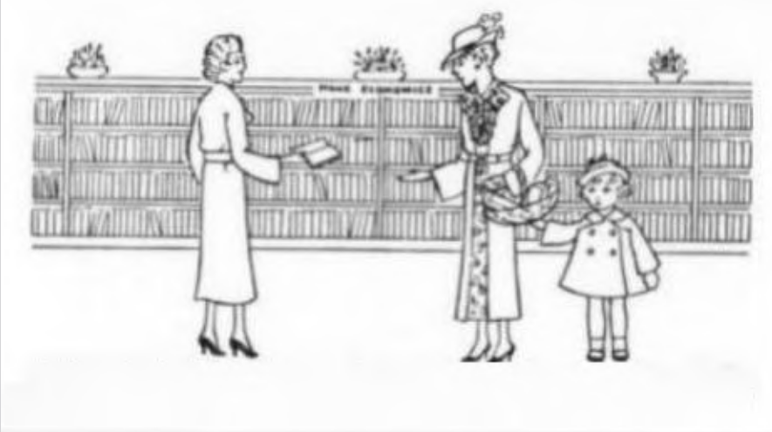
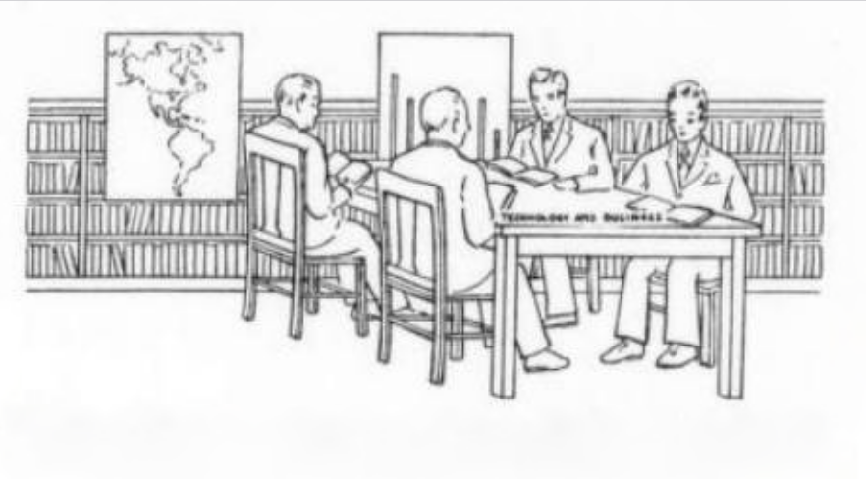
Library Service Then & Now
Notes:
This image from an American Library Association bulletin from 1936 shows some of the library services that exist today and how library staff, buildings, and design considerations can affect the accessibility of your services

Slide 31
Attitude towards Users
Reflect on the biases embedded in your service policies
Securitization in libraries creates a lot of issues for mentally ill, disabled, and/or neurodivergent users

Slide 32
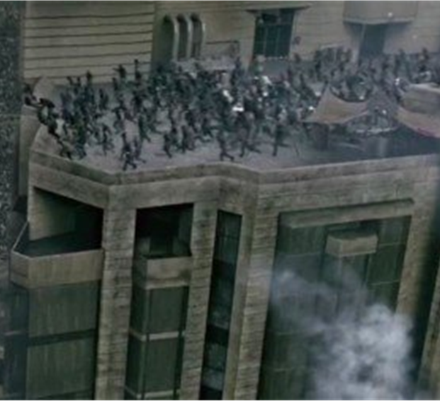
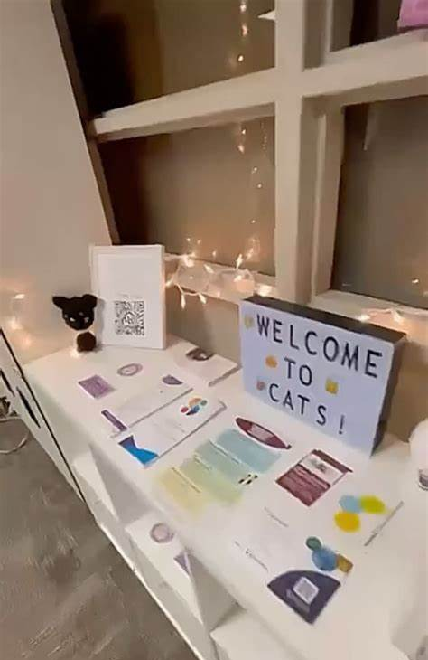
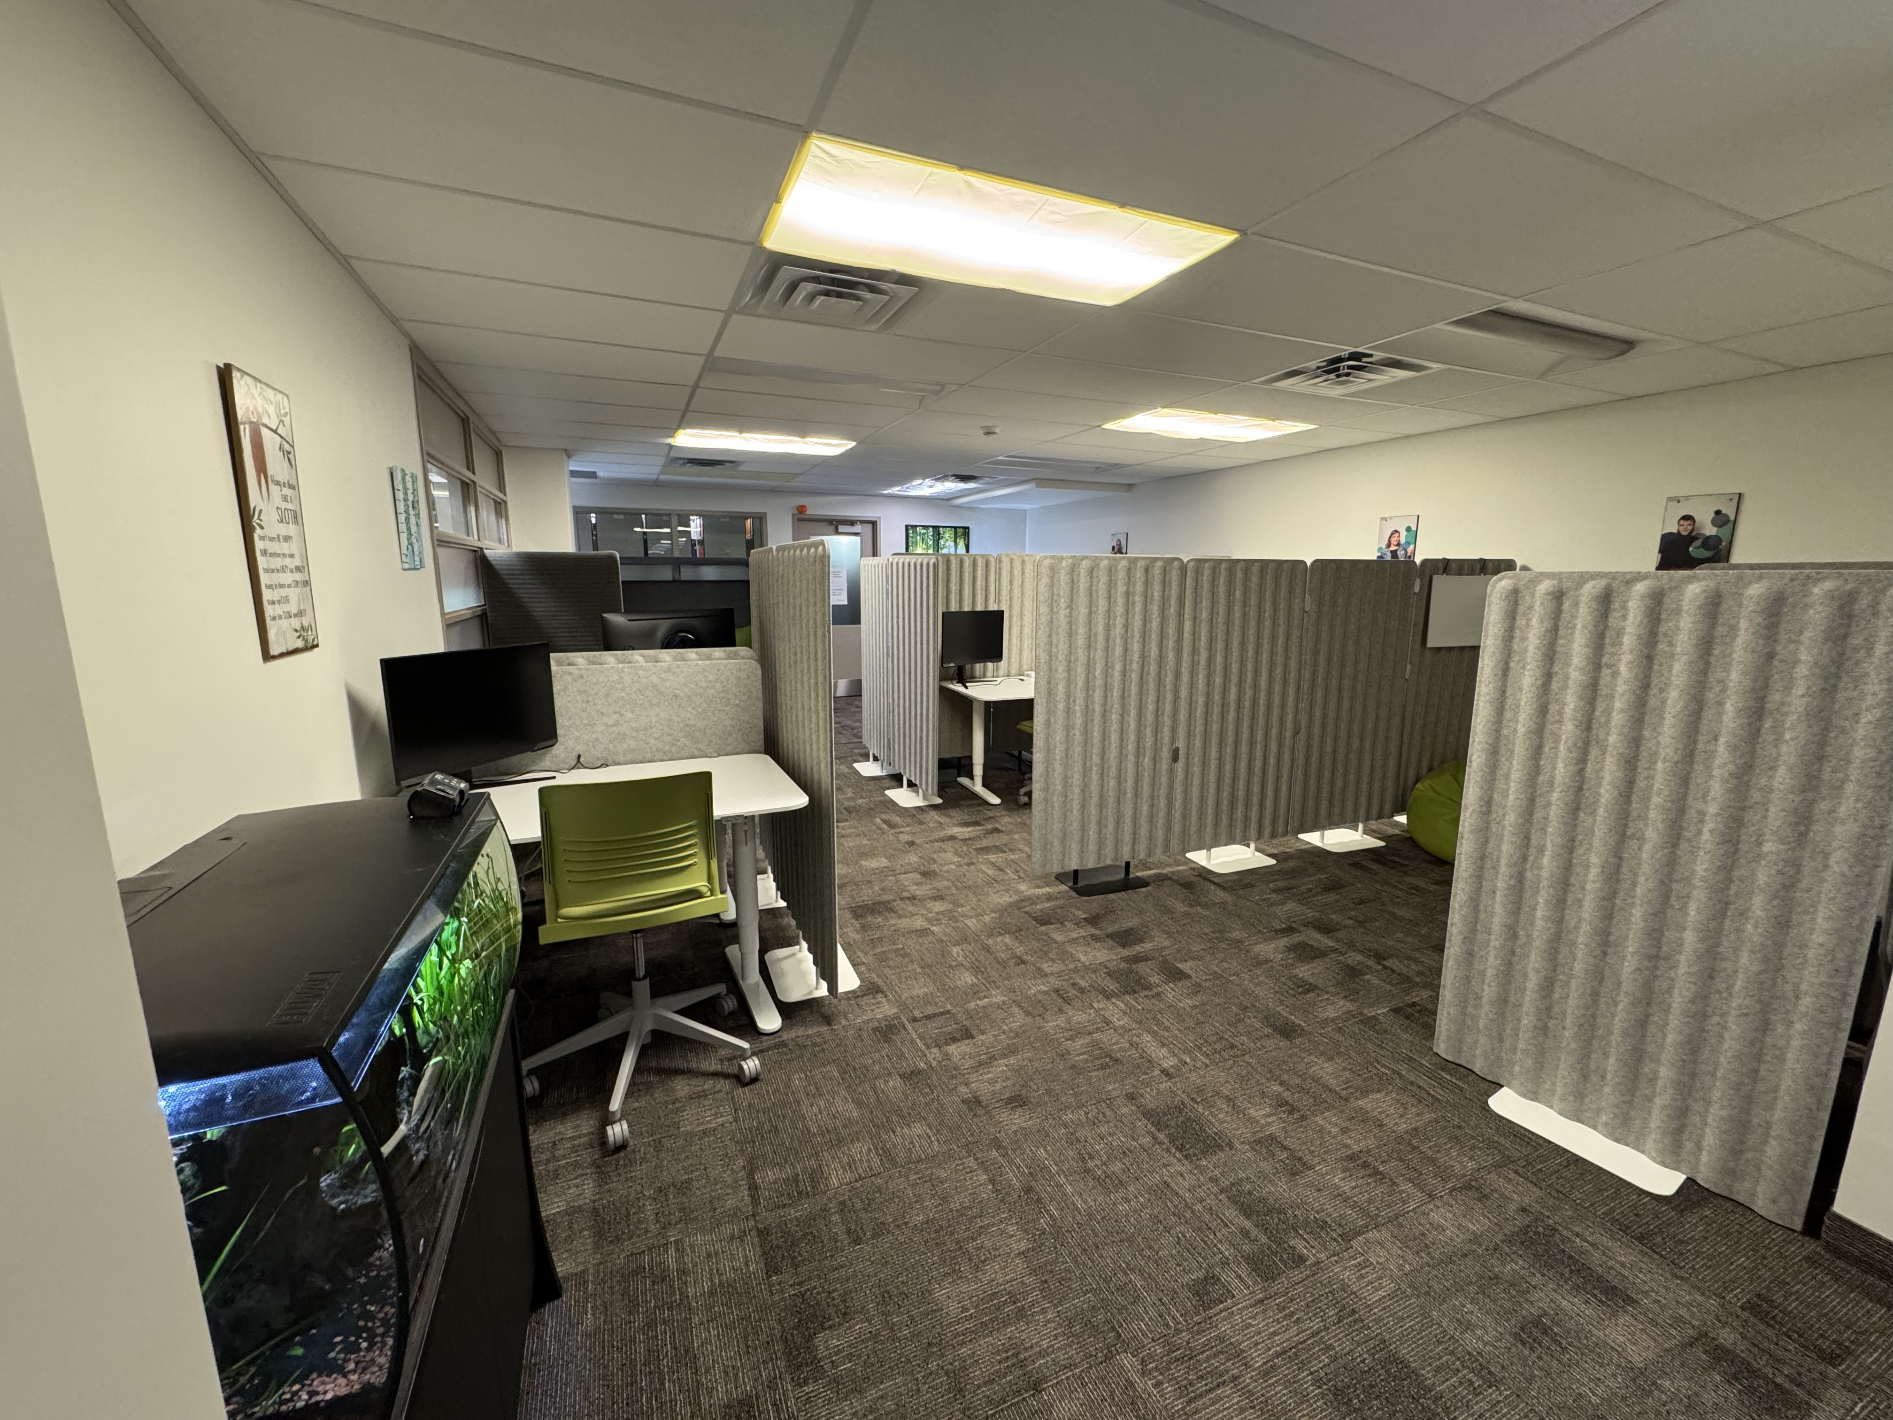
Built Environment
Providing examples of good vs bad library environments for providing accessible services
Notes:
McMaster's Campus Accessible Tech Space (CATS)♿ Accessibility & Accommodations
CATS is designed to be a welcoming, low-distraction environment that supports diverse accessibility needs. Here’s what you’ll find inside:
Wheelchair-accessible space with wide pathways and low-profile thresholds
All desks are height-adjustable in the study area
Two sound-dampening couches for quiet, partially isolated study or downtime
Library book renewals are available right at our service desk
De-stress zone with games, puzzles, and knitting kits

Slide 33
Library Culture
Many examples based on personal experience and readings, with lots of references
Accessibility was prioritized during the beginning of the COVID pandemic, and the scaling back of work-from-home, hybrid events, and public health measures specifically has exacerbated inequities
Offering accessible programs to students but not staff or faculty is a bad thing to do

Slide 34
Questions for Panelists

Slide 35
What previous experience did you have with accessibility work?
Notes:
KM- very little! So I was unsure about taking this on. I think that’s a big barrier to working on accessibility it the feeling we have to be an expert, but perfection is the enemy of progress right? So it's important to me to make efforts to continue to learn and try
KH - Learning about and incorporating practices like Universal Design for Learning in my teaching. Accessible Education Fellows project with Anna investigating how to make screenshots and live demos more accessible for learners led to some research into accessible teaching in libraries. This helped me get into the literature on accessibility in libraries a bit more and develop some comfort there.
NW - I have worked as the Coordinator for Library Accessibility Services since 2013. In this position, I work directly with students with disabilities, ensuring their course and library materials are accessible. I am also the Co-chair of the Accessibility Community of Practice at McMaster, as well as serving on a number of committees both on and off campus.

Slide 36
Why did you decide to participate in this project?
Notes:
KM – consults are a big part of my role and I've never found resources that were a clear support prior. So I wanted to put together something that could serve as a stepping stone
MF – I was invited to go to Robarts Library for a couple of days of meetings and encountered a lot of accessibility barriers that frustrated and stressed me out, but I was dismissed when I raised my concerns. This was a big inspiration for my chapter.
NW - I decided to participate in this project as it was an opportunity to connect with others and talk about how important accessibility is, but that it is not an insurmountable hurdle that one needs to navigate alone. First and foremost its communicating with students about their needs, similar to any service interaction.

Slide 37
Tell us about your experience working on this project
Notes:
KH – I wrote a chapter about about accessibility in library outreach events and learned a lot. There is a fair amount written on this topic but I hadn't done a lot of these types of events previously and I wouldn't have known where to start, until I started trying to compile all that I was finding into a chapter. I also learned a lot from reading the work of my colleagues in their chapters. The authors on this project seemed to be really interested in learning more about their topics and working on their chapters, which made moving the project along pretty easy.
MF – it was stressful at times with competing priorities, but as it was not a very long chapter, it was not a long-term commitment. After writing the chapter I am wondering about the availability of metrics and how to promote the pressbook as it is a new format for me. NW – I found this experience easy, the topic was a passion for me, so the writing flowed. And I felt that we had a reasonable amount of time to write and revise the content that we chose to submit.

Slide 38
Q&A Period

Slide 39
Thank You!
Questions? Find us:
Matthew Fesnak
fesnakm@mcmaster.ca
Anna Flak
flaka1@mcmaster.ca
Katie Harding
kharding@mcmaster.ca
Katie Merriman
merrimkv@mcmaster.ca
Nancy Waite
waitenm@mcmaster.ca
CREDITS: This presentation template was created by Slidesgo, including icons by Flaticon, and infographics & images by Freepik

