Slide 1
Perceived and Unperceived Barriers to Access for Gaming Library Collections
Michelle Goodridge, MA MLIS Wilfrid Laurier University

Slide 2
Agenda
02. Discoverability
01. Accessibility Framework/Game Industry Overview
03. Inclusive Programming
04. Collection Development
05. User Support
06. Closing Thoughts

Slide 3
Accessibility Framework
Cognitive
Emotional
Physical and Visual
Socioeconomic
Diversity in Portrayal
Intersectional
Modified from Meeple Like Us framework

Slide 4
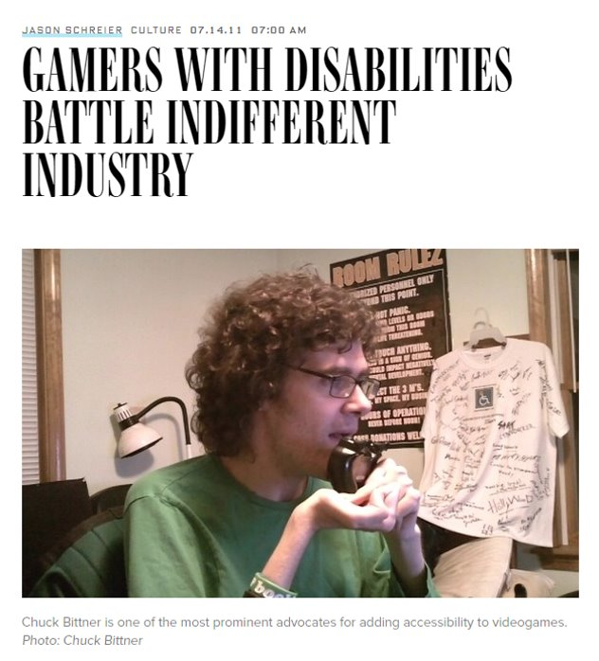
Game Industry Overview
Nintendo was one of the first to create an accessible controller, but you had to purchase it directly in the 1980s​
In 2015 the U.S. FCC required game communication between players on consoles to be accessible for those with sensory disabilities​
2018 marks a big change in game accessibility with the first purpose built adaptive controller being released for mass market by Microsoft​ Many companies are trying to retrofit existing titles for accessibility while some work around different play styles (eg. Celeste allows you to slow the game down or become invincible)​
There are several companies who design purpose built adaptive controllers (eg. CanAssist, Evil Controllers) In 2016, Michael Heron started Meeple Like Us with a focus on boardgame accessibility​ but there are no industry standards

Slide 5
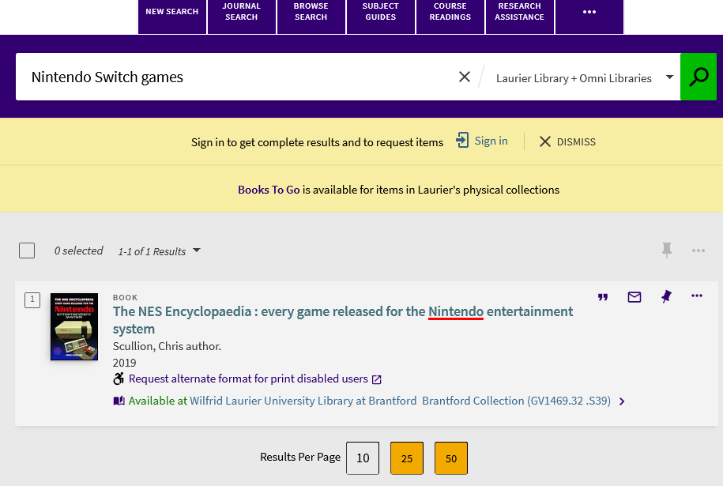
Discoverability
Cataloguing of games using existing library systems presents a lot of challenges Finding specific games by title or system is difficult and inconsistent
Many libraries turn to outside solutions to organize games and present accessibility information related to it
We can explore adding local accessibility notes in MARC, but these are not necessarily discoverable or searchable and require additional staff time and training
Libraries need to explore other options including in-library displays and labels to assist with discoverability

Slide 6
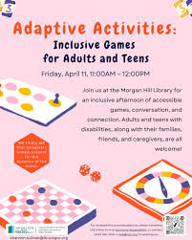
Inclusive Programming
Programming can help promote accessible gaming collections and services
Programs can aim to satisfy the different accessibility framework criteria and support diverse groups of users to create a more inclusive environment
Promoting the collection can also lead to collaborations and opportunities for more programming including language learning, in-class engagement with gaming materials, potential research projects, demonstrated success with achieving accessibility mandates and initiatives, and engaging our users in fun, creative ways
All users can benefit from having access to games that they can engage with and we can use this as an opportunity to create more inclusive spaces and programs in our libraries
Morgan Hill Library (California)

Slide 7
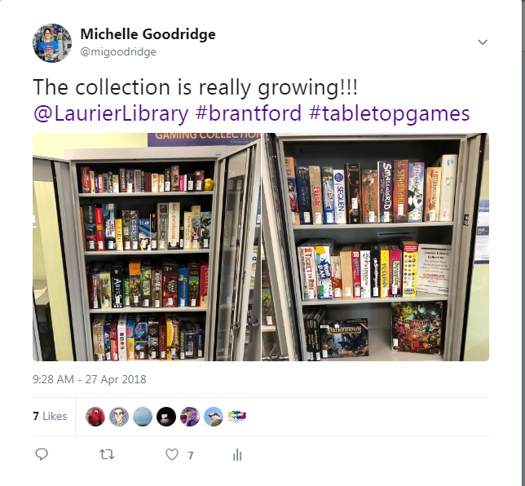
Collection Development
Libraries have the ability to provide more inclusive titles, assistive equipment and remove barriers to access
Finding accessible digital tiles can include referencing champions of game accessibility like Access-Ability UK, accessible game award nominees and winners, or through game blogs/news
For tabletop games, you can refer to the Meeple Like Us Masterlist or Abletop
Both Xbox and Playstation have created adaptive controllers for their current systems
Libraries can also support the creation of more games that are accessible and rally behind initiatives to help shape the industry

Slide 8
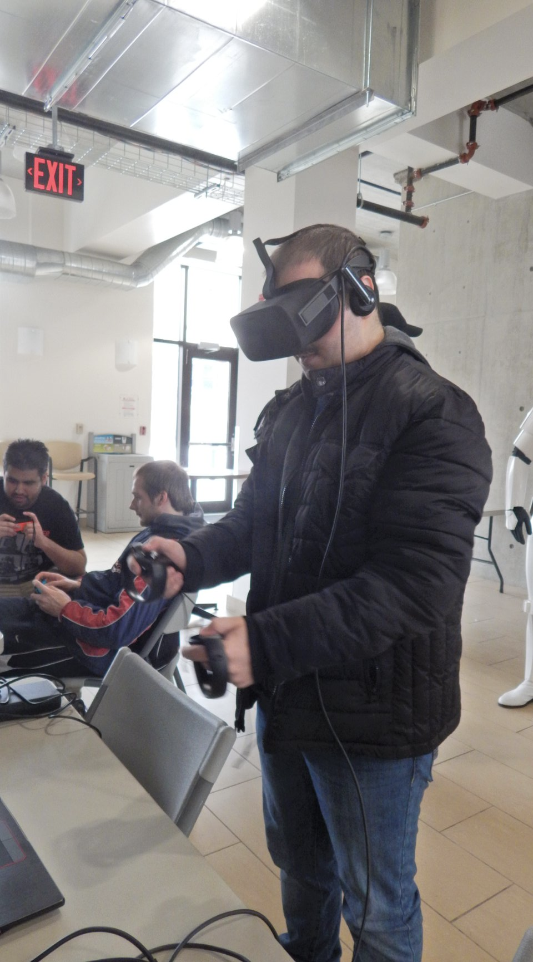
User Support
Having accessible equipment, more accessible games that are discoverable, trained and supportive staff, and a mandate to provide access to these collections positions us well to support our users
All of the initiatives mentioned today are part of a holistic approach to providing our users with the best experience when it comes to gaming collections in libraries
We also need to increase awareness of our collections and how they can serve diverse users with accessible needs

Slide 9
Final Thoughts
Do you have any questions?
mgoodridge@wlu.ca

