Slide 1
Reversing the Gaze: Ontario Library Managers’ Perception of and Experience with Accommodation for Disability
Heather Hill & Kevin Oswald
Faculty of Information & Media Studies
University of Western Ontario

Slide 2
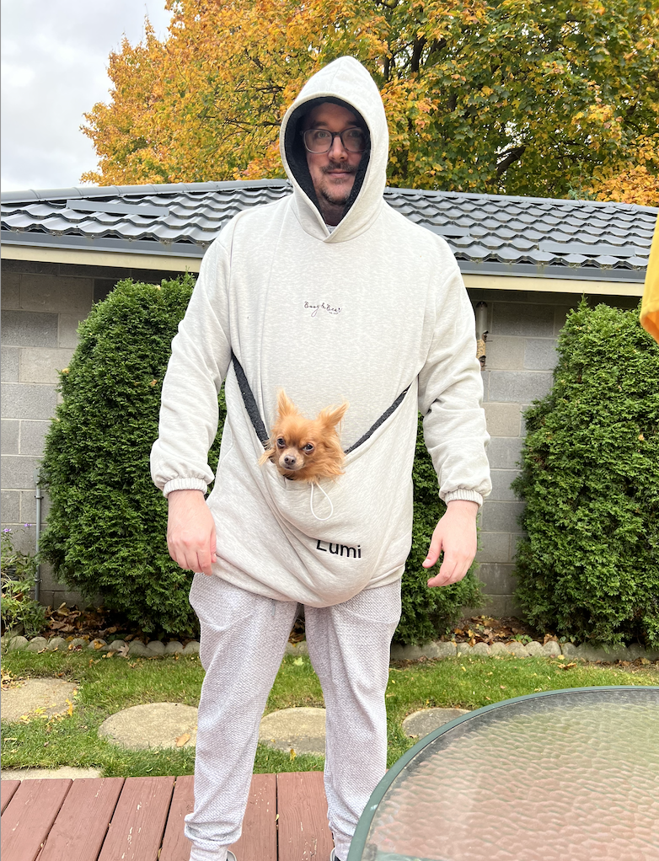
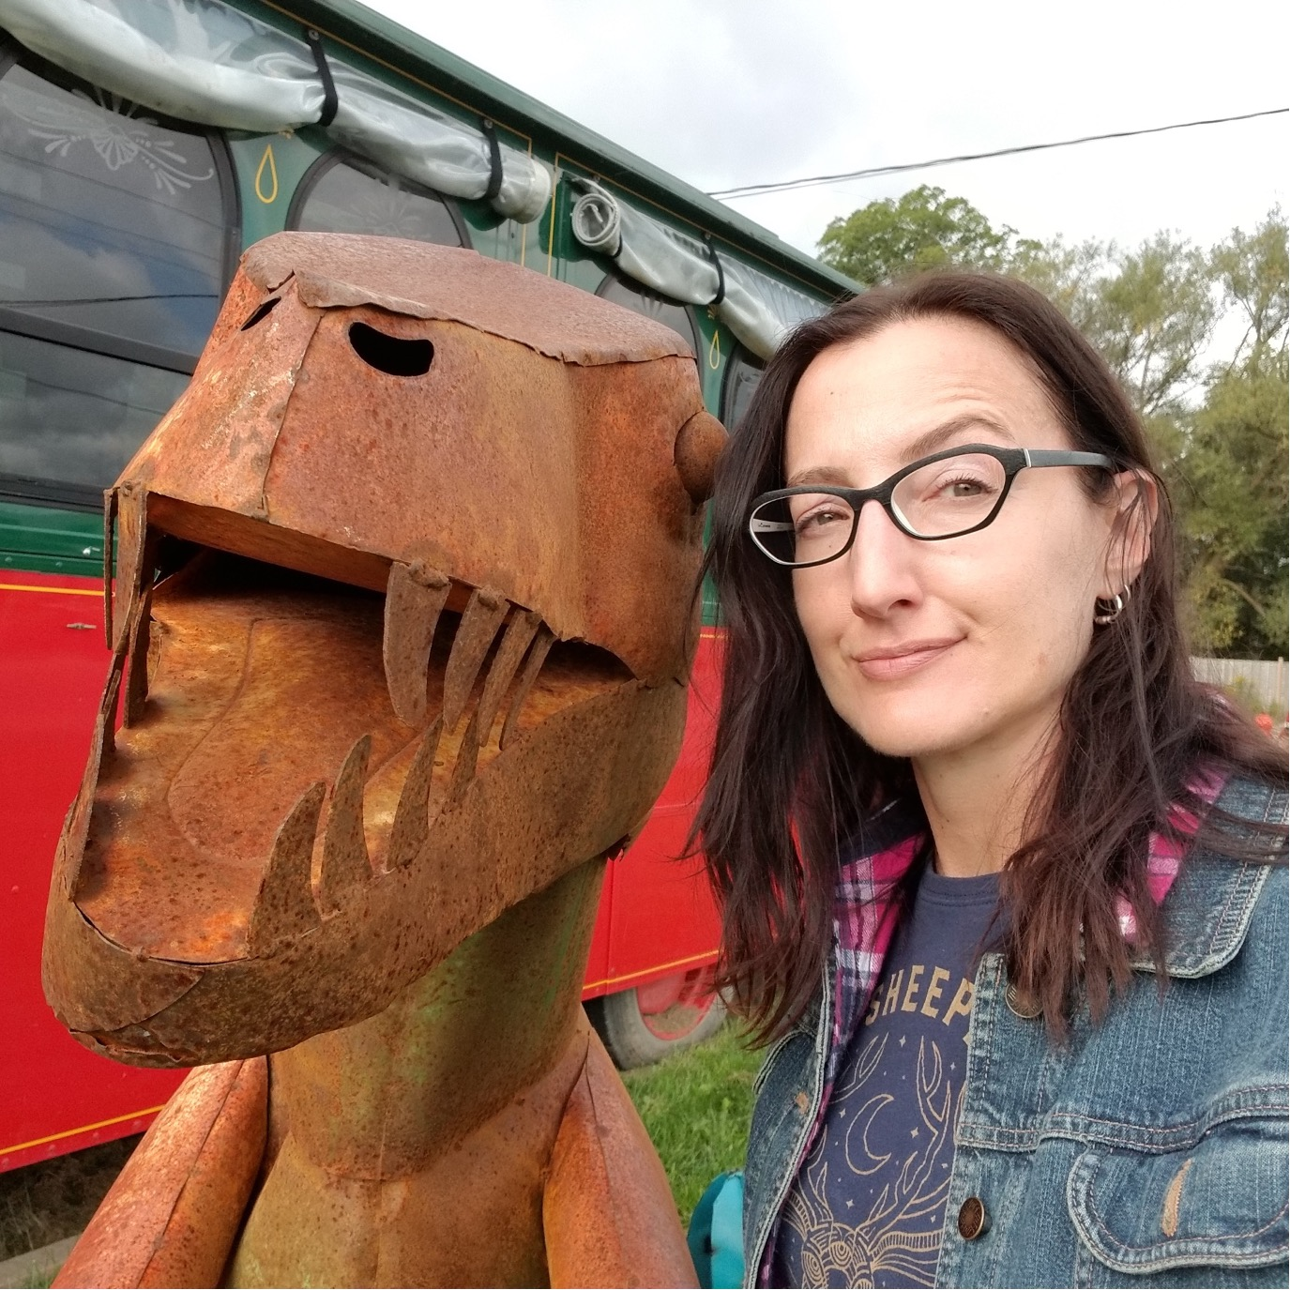
Positionality
C’est moi!
C’est moi!
C’est Kevin (and Lumi)!

Slide 3
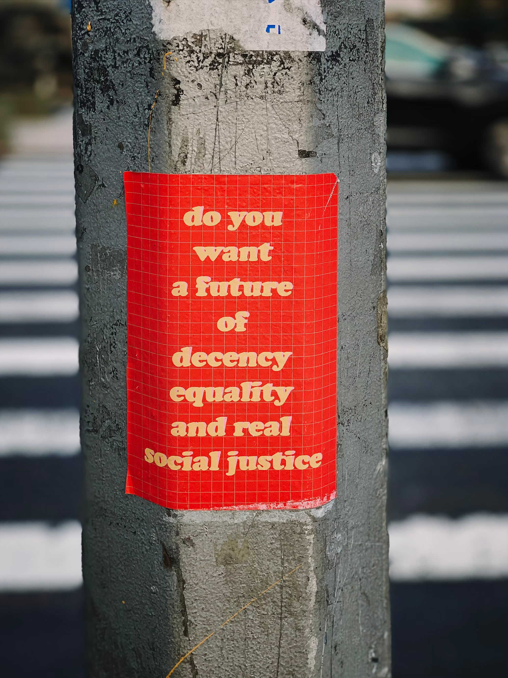
The predicament of disclosure (Prince, 2017)

Slide 4
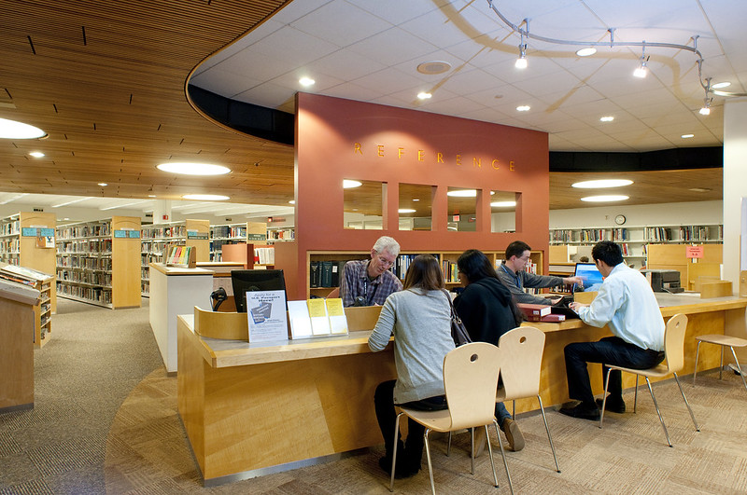
Background

Slide 5
Reversing the Gaze
Strega & Brown, 2015
Potts & Brown, 2015
Anti-oppressive framework
“We suggest that it is only when we reverse the gaze and investigate and problematize the other side of the equation — that is, the behaviours, discourses, and perceptions of the dominant — that we create possibilities for change that are transformative rather than incremental.”

Slide 6
So what did we do?
Interviews
Public library managers
Ontario
5 down and more in the queue

Slide 7
What did we find?
The Interview
“I’ve interviewed many, many people over the years, and I have never had anybody disclose anything during the interview. Um, the disclosures that have come to my attention were always after the person has been offered the job.”

Slide 8
What did we find? (cont.)
Various accommodation processes
Informal vs formal
‘nice’ people vs. ‘not nice’ people
Union vs non-union
Large libraries vs small

Slide 9
Signalling to connect
The job posting
“the library is an equal opportunity employer”
“The [X] Library is hiring [Y] to work part-time in public service and project-based roles...We value diverse perspectives, experiences, and differences, and encourage qualified candidates from all backgrounds and positionalities to apply, including: IBPOC, 2SLGBTQIA+, and persons with disabilities. We are committed to building a diverse team; one that reflects and is representative of community the [X] Library serves. If you require specific support to apply for this position, please get in touch and we will work with you to identify the best way to support you.”

Slide 10
Signalling to connect (cont.)
The interview
Examples of accommodation possibilities
Questions in advance
Schedule
Breaks

Slide 11
Signalling to connect (cont..)
Organizational discourse

Slide 12
Thank you!
Heather Hill
hhill6@uwo.ca
Kevin Oswald * (*Lumi does not use email)
koswald@uwo.ca

