Slide 1
Empowering Inclusive Learning
Leveraging Accessibility Metadata in
Ontario's Post-Secondary Libraries
Charles LaPierre – Benetech
Madeleine Rothberg – National Center for Accessible Media at GBH
Christopher Carr – Concordia University Library

Slide 2
Speakers
Charles LaPierre, Principal Accessibility and Content Quality Architect
Benetech
Madeleine Rothberg, Senior Subject Matter Expert National Center for Accessible Media at GBH
Christopher Carr, Special Materials Cataloguing Librarian
Concordia University Library

Slide 3
Overview
What is Accessibility Metadata
Metadata Crosswalk between EPUB/ONIX/MARC/UNIMARC
Accessibility Metadata Guide 2.0 (Newly Released)
Library Metadata
What you can do
Questions

Slide 4
What is Accessibility Metadata?
Information meant to be read by a computer about how accessible or inaccessible the resource is
Can provide information on
Accessibility features
Accessibility hazards (if any)
Accessibility accommodations for reading
Conformance to WCAG
Certification
Human-readable summary of accessibility

Slide 5
Where Can it Be Found?
Inside the EPUB
OPF File contains the accessibility metadata
Outside the EPUB (Separate metadata file)
ONIX
New metadata provides full coverage: ONIX 3.0 or later
MARC records (derived from EPUB or ONIX metadata)

Slide 6
How Can it Be Used?
Publishers
Disclosing the accessibility of their publications
Bookstores
Help customers find accessible materials to make informed purchasing decisions
School / Library
Make informed purchasing decisions and document progress toward obligations
End User
Ensures what you are about to read or buy will meet your needs

Slide 7
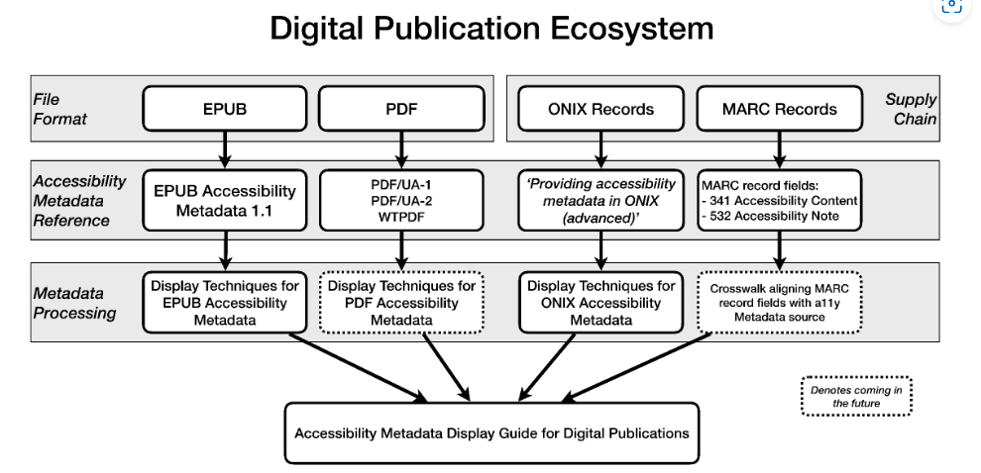
Metadata Ecosystem
https://w3c.github.io/publ-a11y/a11y-meta-display-guide/2.0/draft/guidelines/ - processing-guide
Notes:
The digital publication ecosystem has two main channels of "Metadata Delivery": "Embedded inside the file format", and "Thru the supply chain."
From the "Metadata Delivery" this flows into the "Accessibility Metadata spec" where from "Embedded inside the EPUB" flows into the "EPUB Accessibility Metadata 1.1 specification", and from "the supply chain" flows into the "ONIX Accessibility metadata." At this same level, the "Crosswalk" links between the EPUB and ONIX metadata.
From here both flow down into the "Metadata Processing" layer where the EPUB metadata gets processed through the "Display Techniques for EPUB Accessibility Metadata", and the "ONIX accessibility metadata" is processed through the "Display Techniques for ONIX Accessibility Metadata."
Finally, from the "Metadata Processing" layer both the Display Techniques for EPUB and ONIX flow into the "Resulting Statements" layer "User Experience Guide for Displaying Accessibility Metadata"

Slide 8
3rd Party Certification
Conforms To: EPUB 1.1 Specification WCAG 2.2 - AA
Certified By:
Self-certification (by Publisher / Vendor)
Benetech (GCA)
eBound Canada
Authorized Entities (Libraries – Remediated Content)
Certifier Credential: Global Certified Accessible

Slide 9
Metadata Crosswalk between EPUB/ONIX/MARC
Accessibility Properties Crosswalk (schema.org, ONIX, MARC21 & UNIMARC)
https://w3c.github.io/a11y-discov-vocab/crosswalk/

Slide 10
Accessibility Features Example
https://w3c.github.io/a11y-discov-vocab/crosswalk/#accessibilityfeature

Slide 11
Accessibility Metadata Display Guide 2.0
Principles
https://w3c.github.io/publ-a11y/a11y-meta-display-guide/2.0/guidelines/
Techniques
EPUB Accessibility Metadata
https://w3c.github.io/publ-a11y/a11y-meta-display-guide/2.0/techniques/epub-metadata/
ONIX Accessibility Metadata
https://w3c.github.io/publ-a11y/a11y-meta-display-guide/2.0/techniques/onix-metadata/

Slide 12
Key Accessibility Information
Ways of Reading (required)
Visual adjustments (required)
Support for nonvisual reading (required)
Prerecorded audio
Conformance (required)
Navigation
Rich Content
Hazards
Accessibility summary
Legal considerations
Additional accessibility information

Slide 13
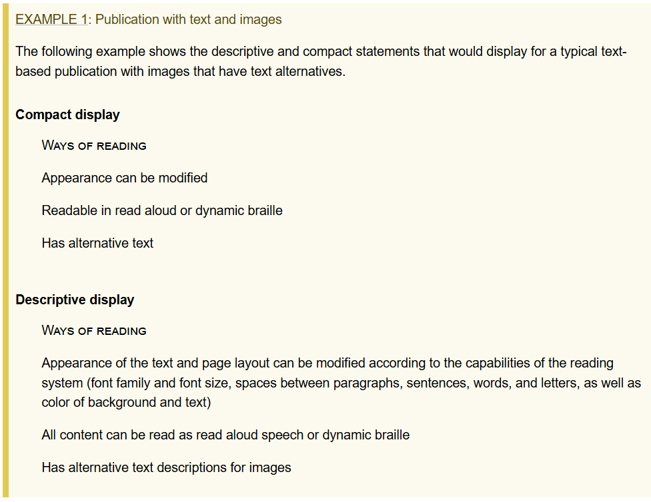
Example: Ways of Reading
https://w3c.github.io/publ-a11y/a11y-meta-display-guide/2.0/draft/guidelines/#example-publication-with-text-and-images

Slide 14
Visual Adjustments EPUB/ONIX
EPUB Technique: https://w3c.github.io/publ-a11y/a11y-meta-display-guide/2.0/draft/techniques/epub-metadata/#visual-adjustments
ONIX Technique: https://w3c.github.io/publ-a11y/a11y-meta-display-guide/2.0/draft/techniques/onix-metadata/#visual-adjustments

Slide 15
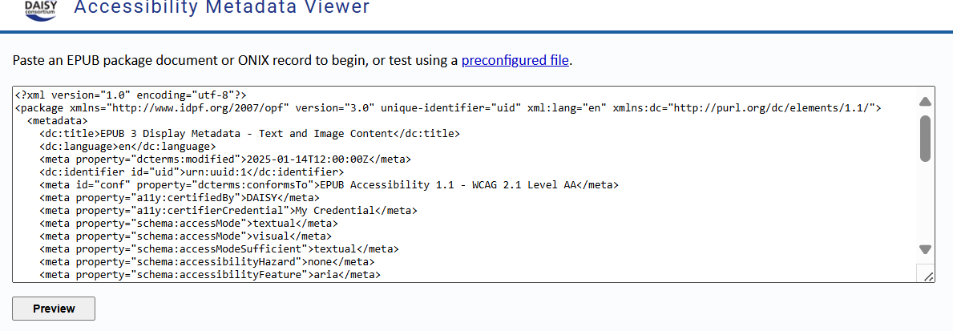
Daisy’s Metadata Previewer
https://daisy.github.io/a11y-meta-viewer/

Slide 16
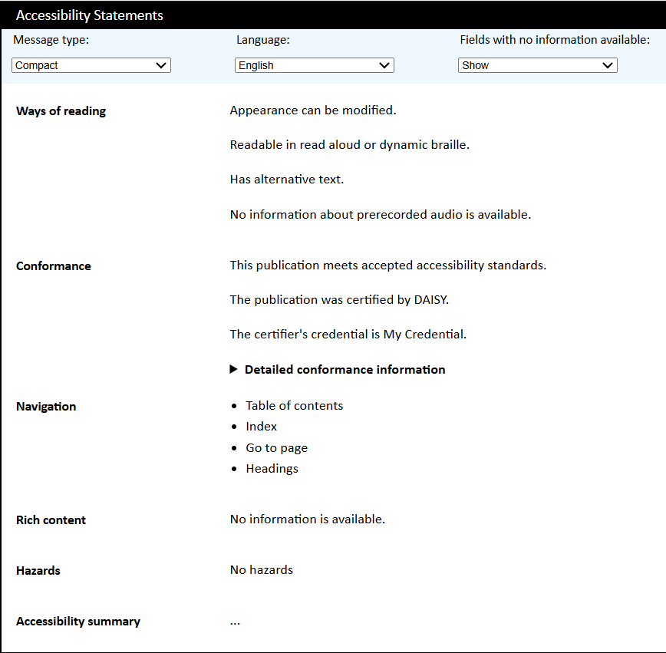
Daisy’s Metadata Previewer - Results

Slide 17
Accessibility Properties Crosswalk
https://w3c.github.io/a11y-discov-vocab/crosswalk/#accessibilityfeature

Slide 18
MARC21 In Accessibility Crosswalk
Crosswalk is focused on EPUB
Identifying how and where to record accessibility metadata found in EPUB Package.
"EPUB Metadata”
Accessibility Standard Conformance
European Accessibility Act Publisher Exemptions
Schema.org Accessibility Properties for Discoverability Vocabulary
Accessibility Features Access Modes
Accessibility Hazards Accessibility Summary

Slide 19
Recording Accessibility in MARC21
MARC21 Accessibility Fields
341 – Accessibility Content
532 – Accessibility Note
Source Codes for Vocabularies, Rules, and Schemes
Accessibility Content Source Codes
sapdv Schema.org Accessibility Properties for Discoverability Vocabulary
onix Online Information Exchange (ONIX)

Slide 20
MARC21 Basics
MARC21 Records are for:
All formats
Accessible Formats (Braille; DAISY; Tactile images, maps…)
Born-accessible digital formats (EPUB)
Adapted or Remediated Resources
Audiovisual Resources (DVD, streaming video, audiobooks)
All sectors (Academic, public, school, national, special…)
All users (novice to advanced, end-users and service providers)
MARC21 is international and multilingual

Slide 21
IFLA LRM User Tasks
Find Controlled vocabulary, keywords
Identify Controlled vocabulary, Notes
Select Controlled vocabulary, Notes
Obtain Notes, URL, Controlled vocabulary
Explore

Slide 22
Basic types of Data Recorded in MARC21
Codes
Language codes (eng, fre, sgn)
ONIX (List 196, Code 14)
Schema.org (structuralNavigation)
Controlled vocabulary
RDA Presentation Format (Panavision)
LC Subject Headings
Free text (Notes, title, pagination, publisher, etc.)
URI (http://dbpedia.org/resource/Santa_Claus)

Slide 23
Schema.org codes vs. ONIX codes
Schema.org (sapdv)
alternativeText
341 0# $avisual$balternativeText$2sapdv
ONIX (onix)
List 196, Code14
341 0# $avisual$b[List 196, Code14]$2onix
341 0# $avisual$b[Short alternative textual descriptions]$2onix
341 0# $avisual$b[14]$2[onix196]

Slide 24
Example ONIX Code
Onix code for Short alternative textual descriptions
List | Code | Heading | ?
196 |  | E-publication Accessibility Details | ✽
196 | 14 | Short alternative textual descriptions All or substantially all non-text content has short alternative (textual) descriptions, usually provided via alt attributes. Note this applies to normal images (eg photographs, charts and diagrams) and also to any embedded audio, video etc. Audio and video content should include alternative descriptions suitable for hearing-impaired as well as for visually-impaired readers. (Purely decorative non-text content can be ignored, but the accessibility of resources delivered via a network connection rather than as part of the e-publication package must be included) | ✽

Slide 25
Sample ONIX message with Accessibility Codes
<ProductFormFeature>
<ProductFormFeatureType>09</ProductFormFeatureType> <!-- list 79 indicates it is a value taken from list 196 -->
<ProductFormFeatureValue>13</ProductFormFeatureValue> <!-- list 196 Single logical reading order -->
</ProductFormFeature>
<ProductFormFeature>
<ProductFormFeatureType>09</ProductFormFeatureType> <!-- list 79 indicates it is a value taken from list 196 -->
<ProductFormFeatureValue>14</ProductFormFeatureValue> <!-- list 196 Images have short alternative descriptions -->
</ProductFormFeature>
<ProductFormFeature>
<ProductFormFeatureType>09</ProductFormFeatureType> <!-- list 79 indicates it is a value taken from list 196 -->
<ProductFormFeatureValue>76</ProductFormFeatureValue> <!-- list 196 publisher claiming EAA exception 2 - Disproportionate burden -->
</ProductFormFeature>
<ProductFormFeature>
<ProductFormFeatureType>09</ProductFormFeatureType> <!-- list 79 indicates it is a value taken from list 196 -->
<ProductFormFeatureValue>92</ProductFormFeatureValue> <!-- list 196 Accessibility addendum for additional information not described in codes or where clarity is required-->

Slide 26
Presenting Accessibility Metadata to the End User
341 0# $atextual$bdisplayTransformability$bpageBreakMarkers $btableOfContents$breadingOrder$2sapdv
341 0# $avisual$balternativeText$2sapdv
532 ## $aCompliant with Level AA of the Web Content Accessibility Guidelines. Content is displayed as HTML full text which can easily be resized or read with assistive technology, with mark-up that allows screen readers and keyboard-only users to navigate easily.

Slide 27
Display Techniques
341 0# $avisual$balternativeText$2sapdv
Possible display: Alternative text
341 0# $avisual$b[List 196, Code14]$2onix
Possible display: Short alternative descriptions
Accessibility Metadata Display Guide for Digital Publications
alternativeText, longDescription, describedMath, transcript
Compact: Has alternative text
Descriptive: Has alternative text descriptions for images

Slide 28
Metadata Sharing, Interoperability, Internationalization
Sharing Adapted/Remediated Resources
EMMA
Accessible Books Consortium
Voilà
Requirements for Sharing Resource Descriptions
Standardized description practices
Standardized codes, vocabularies
Multilingual thesauri

Slide 29
Current and Future Work
Soon to be released Crosswalk of the EPUB->ONIX->MARC
MARC Discussion Paper No. 2025-DP12
IFLA Accessibility Metadata Network
Other Accessibility Metadata Projects
NISO Accessibility Remediation Metadata (New Standard)
https://www.niso.org/standards-committees/arm
EMMA -- Educational Materials Made Accessible

Slide 30
MARC Discussion Paper No. 2025-DP12
Presence or Absence of Accessibility Features
Definition of Second Indicator in Field 341
Sensory Hazards
Definition of new subfield for hazards in Field 341
Accessibility Standard Conformance
Addition of Display Constant for Conformance in Field 532
Addition of Subfields to provide granular conformance metadata
Data Provenance
Definition of subfield $7 in Fields 341 and 532 to permit recording of subfield-level data provenance metadata.

Slide 31
IFLA Accessibility Metadata Network (AMNet)
Network Approved by IFLA Governing Board, April 2024
IFLA Sponsoring Bodies: Cataloguing Section, Advisory Committee on Standards, Libraries Serving Persons with Print Disabilities, Subject Analysis and Access, Audiovisual and Multimedia Standing Committee
Network Structure
Administrative Group
Group 1. Principles
Group 2. Mappings/Crosswalks
Group 3. Best Practices
Group 4. Vocabularies

Slide 32
What you can do
Talk to Publishers and Ebook Platform Vendors
Produce accessible resources
Provide accessibility metadata, ideally in MARC21
Notify them of discrepancies/errors/weaknesses
Talk to Discovery Layer vendors about Indexing and Displaying Accessibility Metadata
Add Accessibility Metadata to your records
Experiment and Share
Advocate for interoperability between library catalogues and repositories of Adapted/Remediated resources (ARM/EMMA)
Join IFLA AMNet! Join CAPAL-DAAL!

Slide 33
Questions?
Charles LaPierre
charlesl@benetech.org
Madeleine Rothberg
madeleine_rothberg@wgbh.org
Christopher Carr
christopher.carr@concordia.ca

