Slide 1
No, Really, Which Search Engine Do I Use? Making a Guide for Finding Accessible Documents
Presented by Indiana University

Slide 2
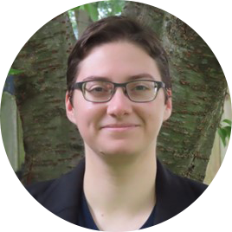
Presenter
Caitlin Malone
Instructional Designer
Teaching & Learning Design (TLT, formerly eLearning Design & Services)
I’ve been training the team and documenting accessibility best practices since 2018.

Slide 3
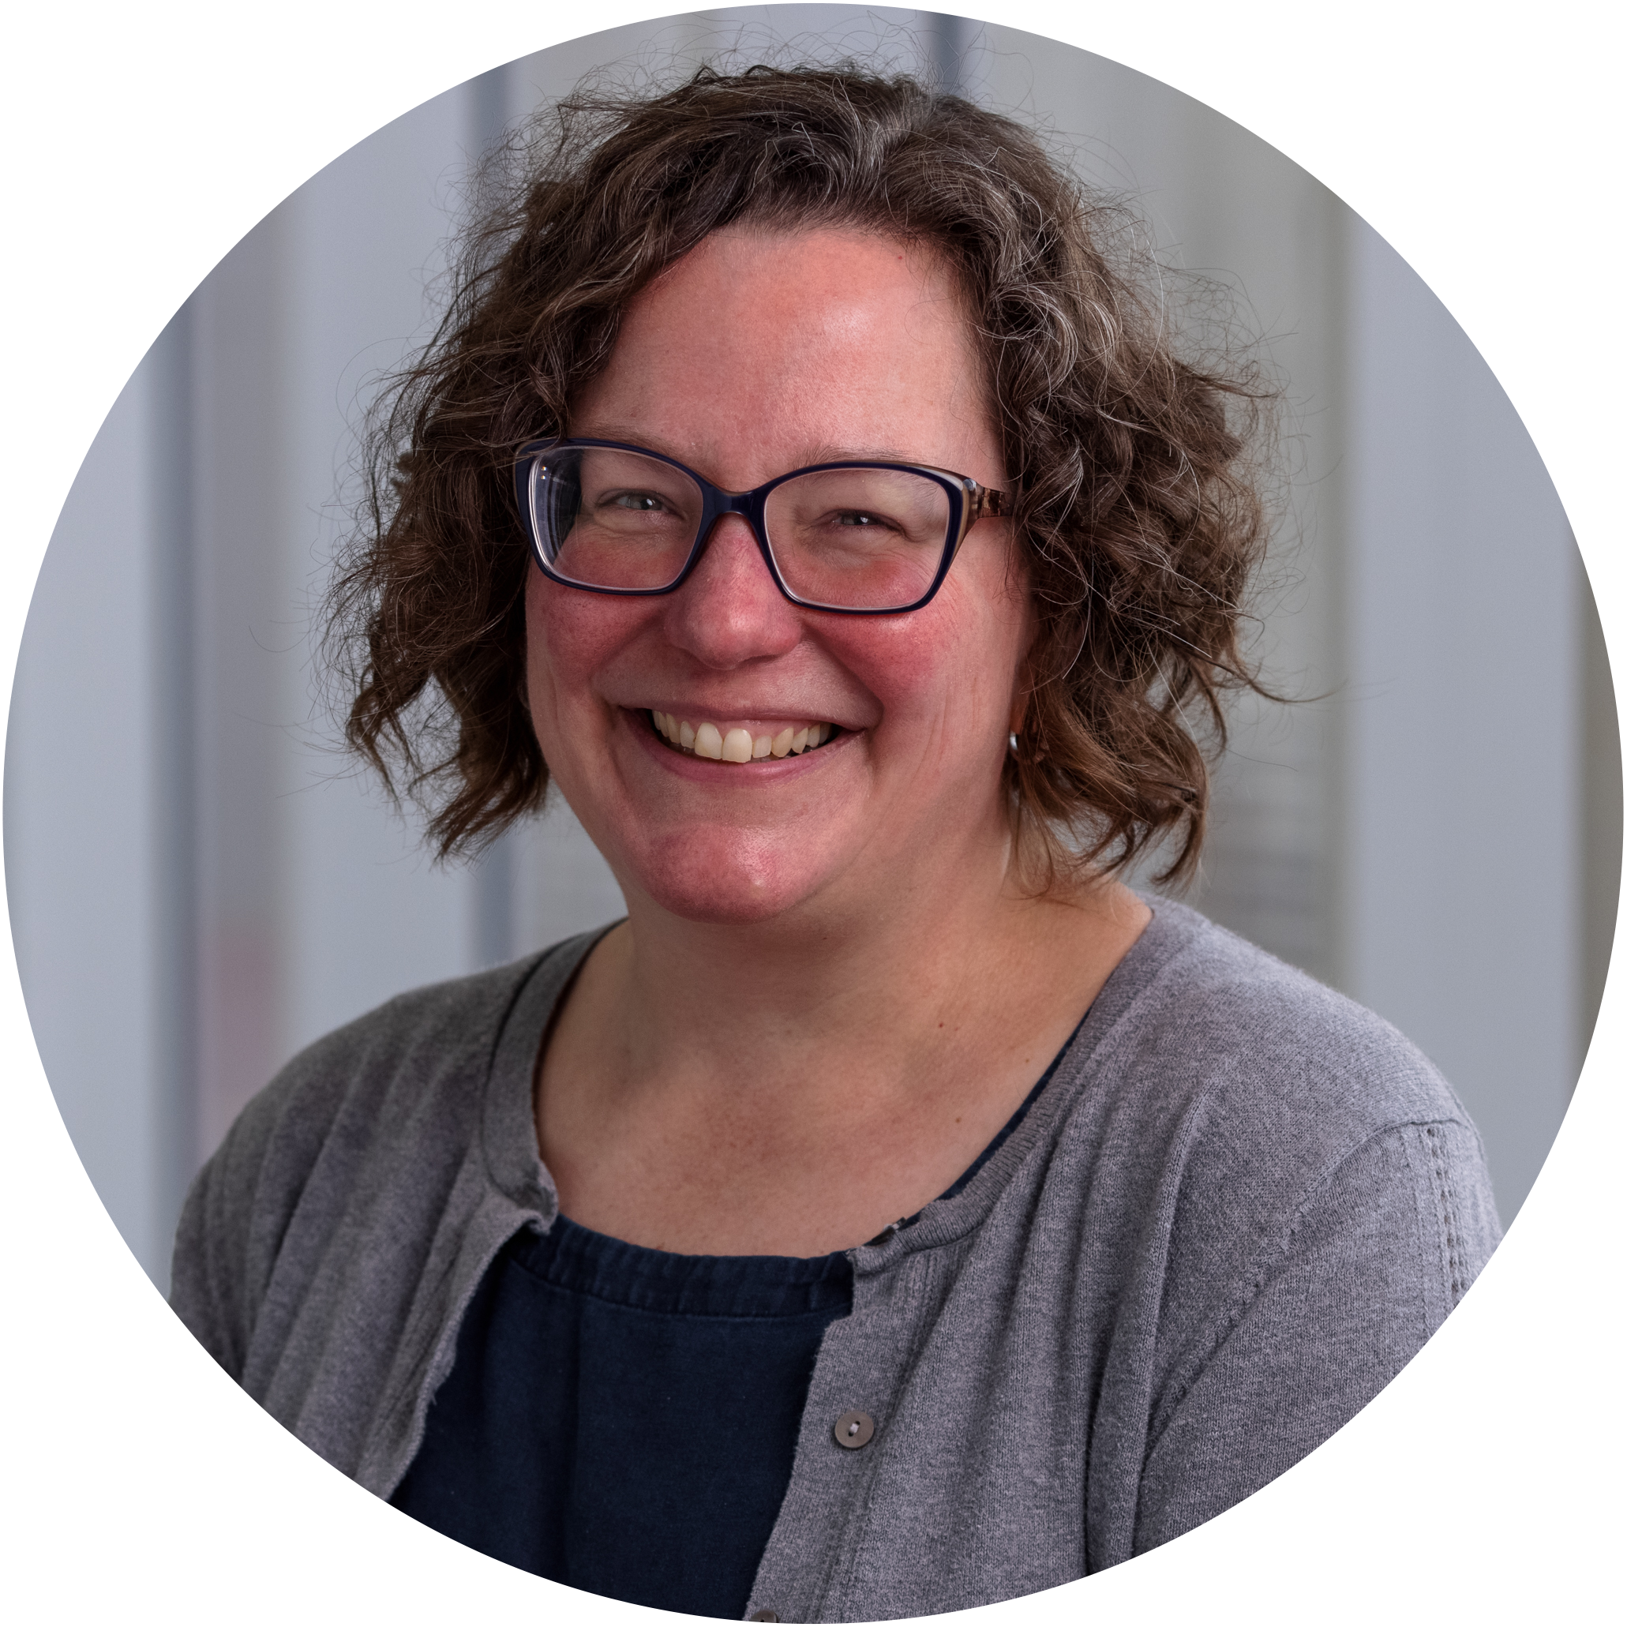
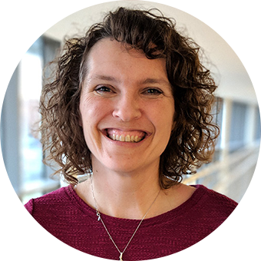
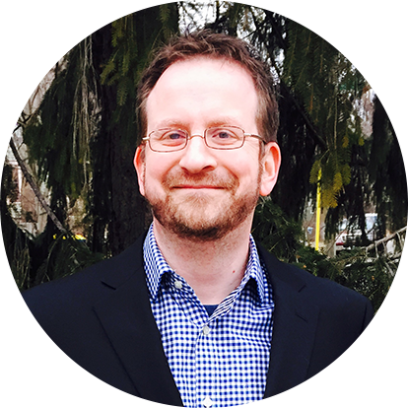
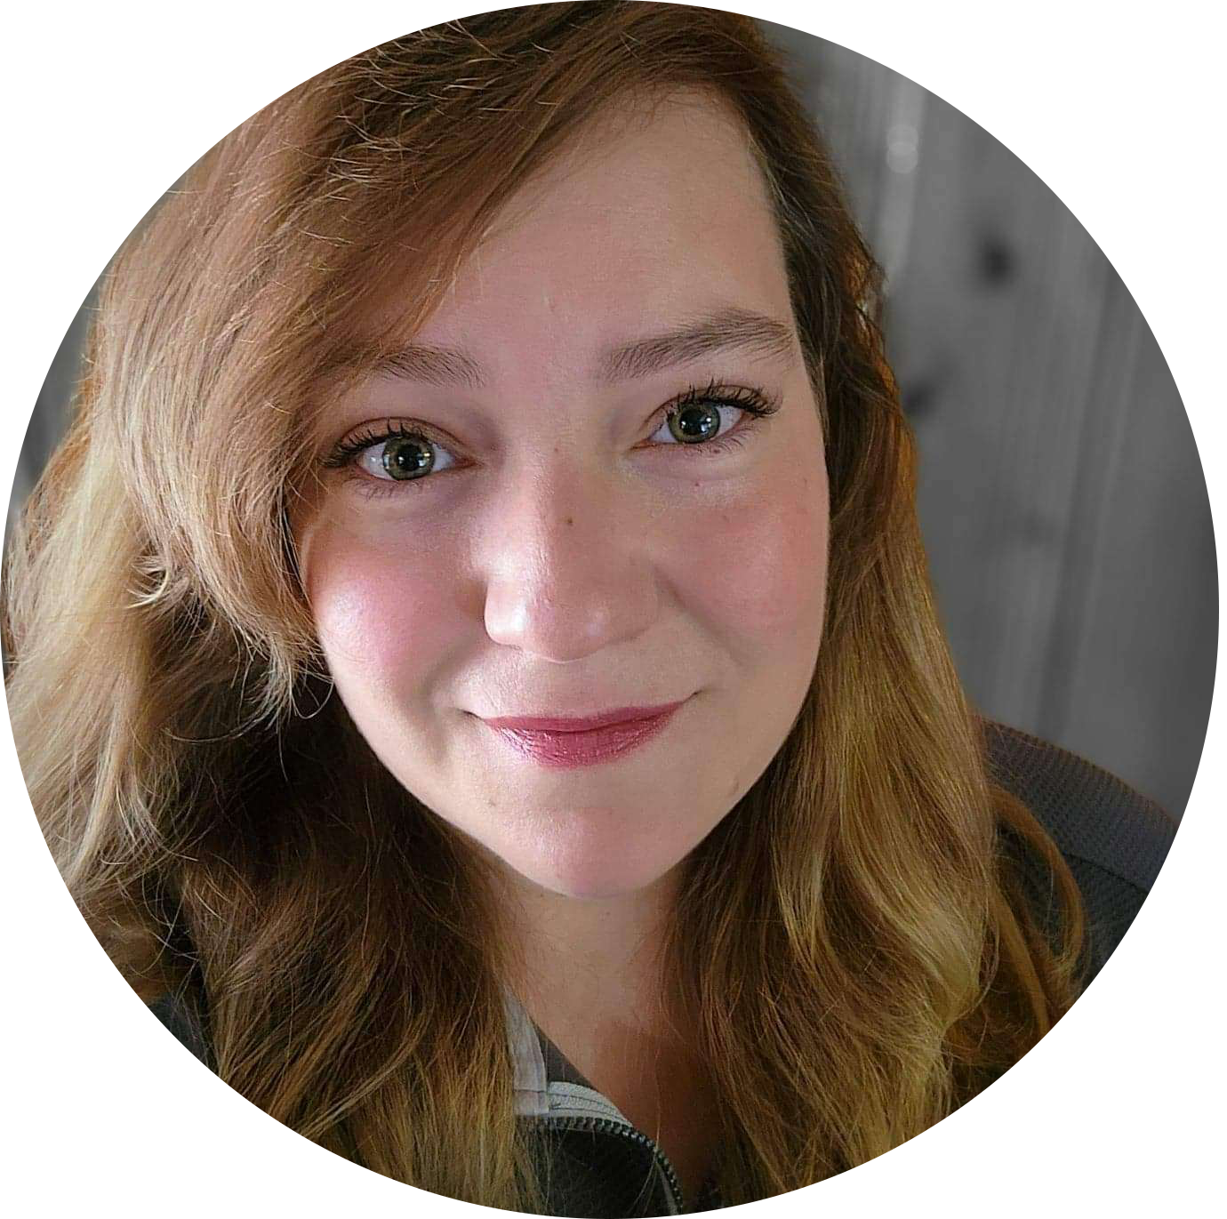
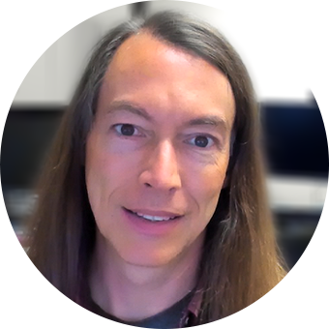
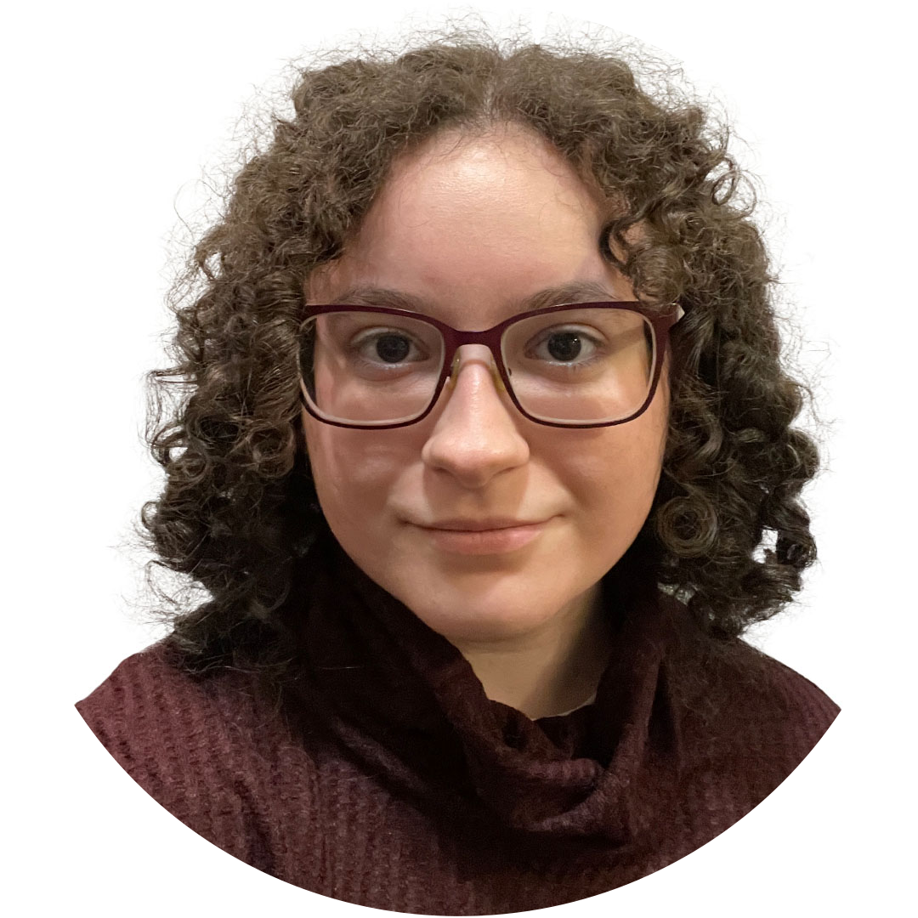
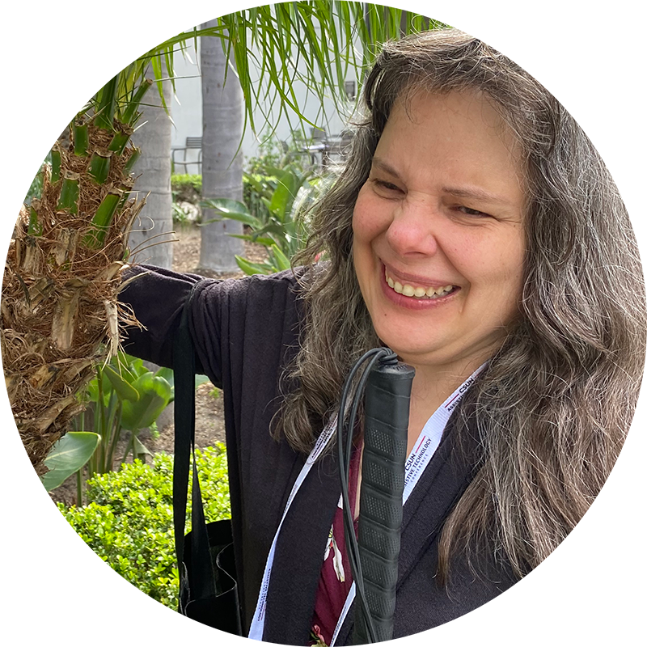
Collaborators
Sara Lowe
IU Indianapolis Library
Resources & Feedback
Carrie Hansel
Teaching & Learning Design
Project Manager
Michael Mace
Assistive Technology and Accessibility Centers (ATAC)
Original workflow
Rin Thomas
Teaching & Learning Design
Project Team, PDF training
Brian Richwine
Assistive Technology and Accessibility Centers (ATAC)
Resources & Feedback
Rebeka Popek
Teaching & Learning Design
Project Team, Math Content
Mary Stores
Assistive Technology and Accessibility Centers (ATAC)
Resources & Feedback

Slide 4
Agenda
Project Overview
The IU Library System
Problems Encountered
Process Used
The Library Linking Guide
Project Results
Reducing Barriers
Takeaways
More Resources

Slide 5
The Project

Slide 6
Who We Are
Teaching & Learning Technologies (university IT)
Instructional designers, service admins, and web developers
Support online courses across all campuses
Notes:
Note: add more about TLT and our role as instructional designers.
IT division that serves all campuses.

Slide 7
How We Got Involved
Major multi-campus initiative
Multiple instructors
Ensure accessible base course
No equivalent multi-campus library division
Notes:
Note: add more about eDS and our role as instructional designers.

Slide 8
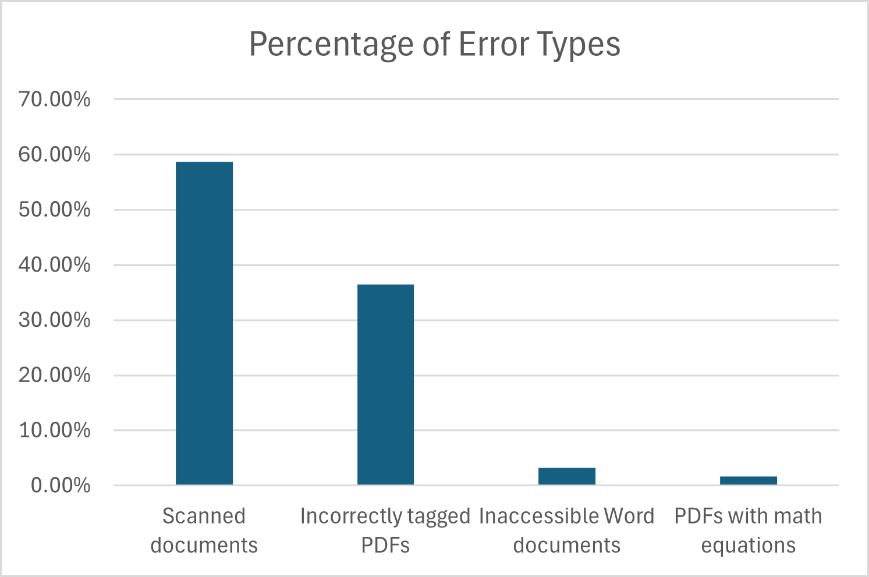
Project At A Glance
Course topic: Informatics law
Inaccessible documents: 104
Error types:
Scanned documents (58.7%)
Incorrectly tagged PDFs (36.5%)
Inaccessible Word documents (3.2%)
PDFs with math equations (1.6%)

Slide 9
Project Challenges
Short deadline
Unfamiliar with libraries
Specialized content
No process yet
Notes:
Note: add more about eDS and our role as instructional designers.

Slide 10
Starting From Scratch
We started out learning the system as complete beginners.
This provided challenges, but also gave us the perspective of a new faculty member or student.
We might be here
Notes:
This presentation is from the perspective of people wholly new to the libraries. So some information may be very familiar to you, but we hope to show you what it can be like if someone comes in without knowing how to get started. Learning and communicating specialized, in-depth knowledge was a major feature of this project.

Slide 11
The System

Slide 12
What We Thought…
One Unified Library System
Campus
Campus
Campus
Campus
Campus
Campus
Campus
Campus
Campus
Use IU Catalog to search all resources on all campuses. Easy!

Slide 13
…What It’s Really Like
So many questions!
Which search engine do I use?
How do we teach students to use the links?
Can we use interlibrary loans?
What are permalinks?
Uh…what’s EBSCOHost?
How do we know if a format is accessible?
Will this really work for all campuses?
What if the document isn’t available?

Slide 14
IU Library System
IU Bloomington
IU Indianapolis & Fort Wayne
IU Columbus
IU East
IU Kokomo
IU Northwest
IU South Bend
IU Southeast

Slide 15
Problems Encountered

Slide 16
Campus Access
Standard Campus Access
Only
Usually, students, faculty, and staff can only access their campus’ library.
However, students can access their instructor’s library resources for the duration of the semester.
TLT needed to request special access to act on behalf of instructor.
Student A
Campus A
IU Online Multi-Campus Access
Student A
Course taught by Instructor B
Campus B

Slide 17
Database Confusion
IUCAT versus OneSearch: the right database makes a big difference!
Campuses may have:
Partial database access
No database access
Specialized archives not in IUCAT or OneSearch
IUCAT
Primarily print & physical materials with some website links.
OneSearch
Primarily online journals, periodicals, and some websites.

Slide 18
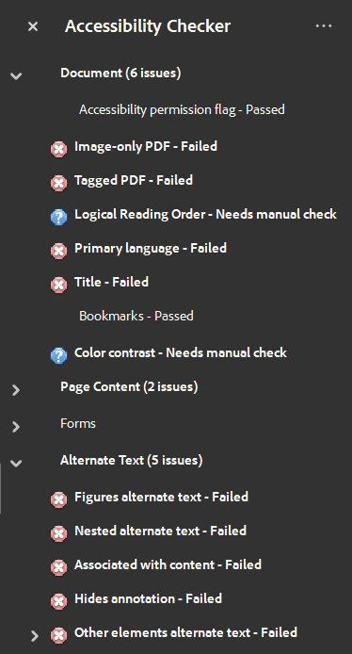
Is It Really Accessible?
Every database format had to be checked for accessibility.
Some were scanned PDFs
Many had errors
Checked with tools, keyboard tests, and manual review
Notes:
Some only provided scanned PDFs, but they were often specialized databases and the documents couldn’t be found anywhere else. One in particular, HeinOnline, had only scanned PDFs, and a machine-generated text-only version that was largely unreadable and didn’t include any images or image descriptions.

Slide 19
Permalink Trouble
Every database had different link formats and requirements.
IUCAT: web URL
Other Databases:
Website name: replace dashes with periods
EZProxy: find and remove
Notes:
Although EZProxy is designed to make life easier for students, it only works for the specific campus in the URL. To account for this, and to limit the number of URLs that we would need to maintain, we elected to remove EZProxy and give students instructions for how to log in and access their documents (which in most databases just required them to log into any IU system and select their campus).

Slide 20
Permalink Edits (1 of 2)
Images courtesy Chongning Sun of Teaching & Learning Technologies.
Notes:
Image description:
The original link is: https://research-ebsco-com.proxyiub.uits.iu.edu/linkprocessor/plink?id=1d...da (link truncated to save space)
The database portion is at the beginning: https://research-ebsco-com
The EZProxy part is in the middle, but may appear at different parts of the URL: .proxyiub.uits.iu.edu
The resource link portion is at the end: /linkprocessor/plink?id=1d…da (shortened to save space)

Slide 21
Permalink Edits (2 of 2)
Images courtesy Chongning Sun of Teaching & Learning Technologies.
Notes:
Image description:
The original link is the same as before: https://research-ebsco-com.proxyiub.uits.iu.edu/linkprocessor/plink?id=1d...da (link truncated to save space)
Step 1: Remove the EZProxy portion: .proxyiub.uits.iu.edu
Step 2: Edit the database portion and replace dashes with periods, with the result being: https://research.ebsco.com
Step 3: Keep the resource link the same: /linkprocessor/plink?id=1d…da

Slide 22
Our Process

Slide 23
Project Management
Project management software was essential.
Coordinating tasks & following up on issues was a full-time job
System developed over time
Helps auto-track time spent, # of documents, issues
Multiple conversations at once
Top-level project
Document 1
Complete
Document 2
In Progress
Document 3
In Progress
Note: Couldn’t find using OneSearch or IUCAT. Trying a specialized search in HeinOnline and JSTOR.
Notes:
We learned the hard way that project management software was essential.

Slide 24
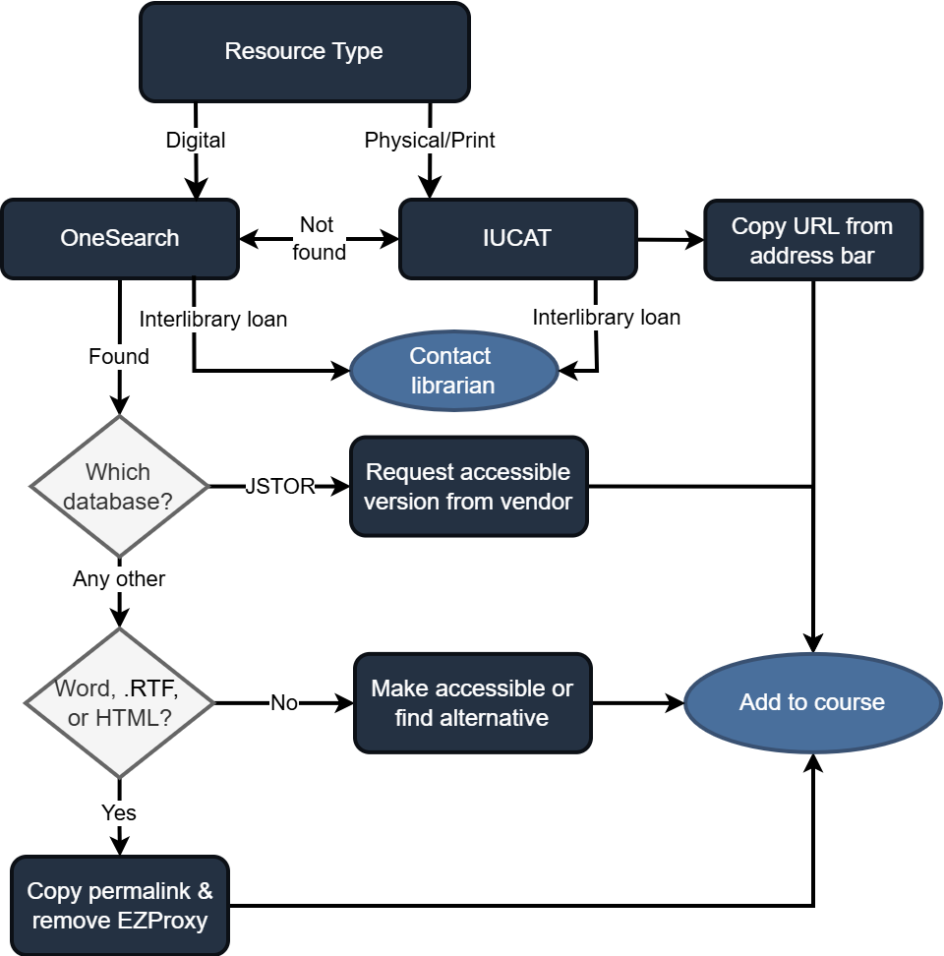
Steps Taken
List all documents in central place.
Identify inaccessible documents.
Search campus OneSearch.
Search campus IUCAT.
Check topic-specific databases.
Check document accessibility.
Edit permalink.
Add to course and test.

Slide 25
Collaboration
Collaboration was essential too!
Started with campus resources/guides.
Liaised with Sara from IU Indianapolis Libraries for advice and feedback.
Received draft feedback and accessibility advice from Brian and Mary of the ATAC.

Slide 26
The Library Linking Guide

Slide 27
What Should Be Included?
Already a large document – we wanted to avoid information overload.
Quick overview of each section.
What to look for in each system.
What they will do and why they’ll do it.
Step-by-step instructions only.

Slide 28
What Should Be Left Out?
Some details are important but advanced knowledge.
Understanding URLs (except to complete task)
Differences in formats (PDF, Word, HTML, etc.)
Be consistent and avoid too much jargon
Specifics of each database/library system
Will connect with librarians instead

Slide 29
Feedback & Refinement
Shared with Library and ATAC for feedback.
Gave each database its own section.
Clarified confusing information.
Fixed errors in process/details.

Slide 30
Final(-ish) Structure
Introduction explaining Library systems and definitions.
Flowchart for deciding process.
Separate sections for each database.
How to add and update links in Canvas.
Contact info for each campus library.

Slide 31
Future Additions
Additional databases
Multimedia databases/resources (e.g. Academic Video Online, Kanopy)
Updates to accessibility info regarding Title II
Customized versions for specific schools/programs

Slide 32
Project Results

Slide 33
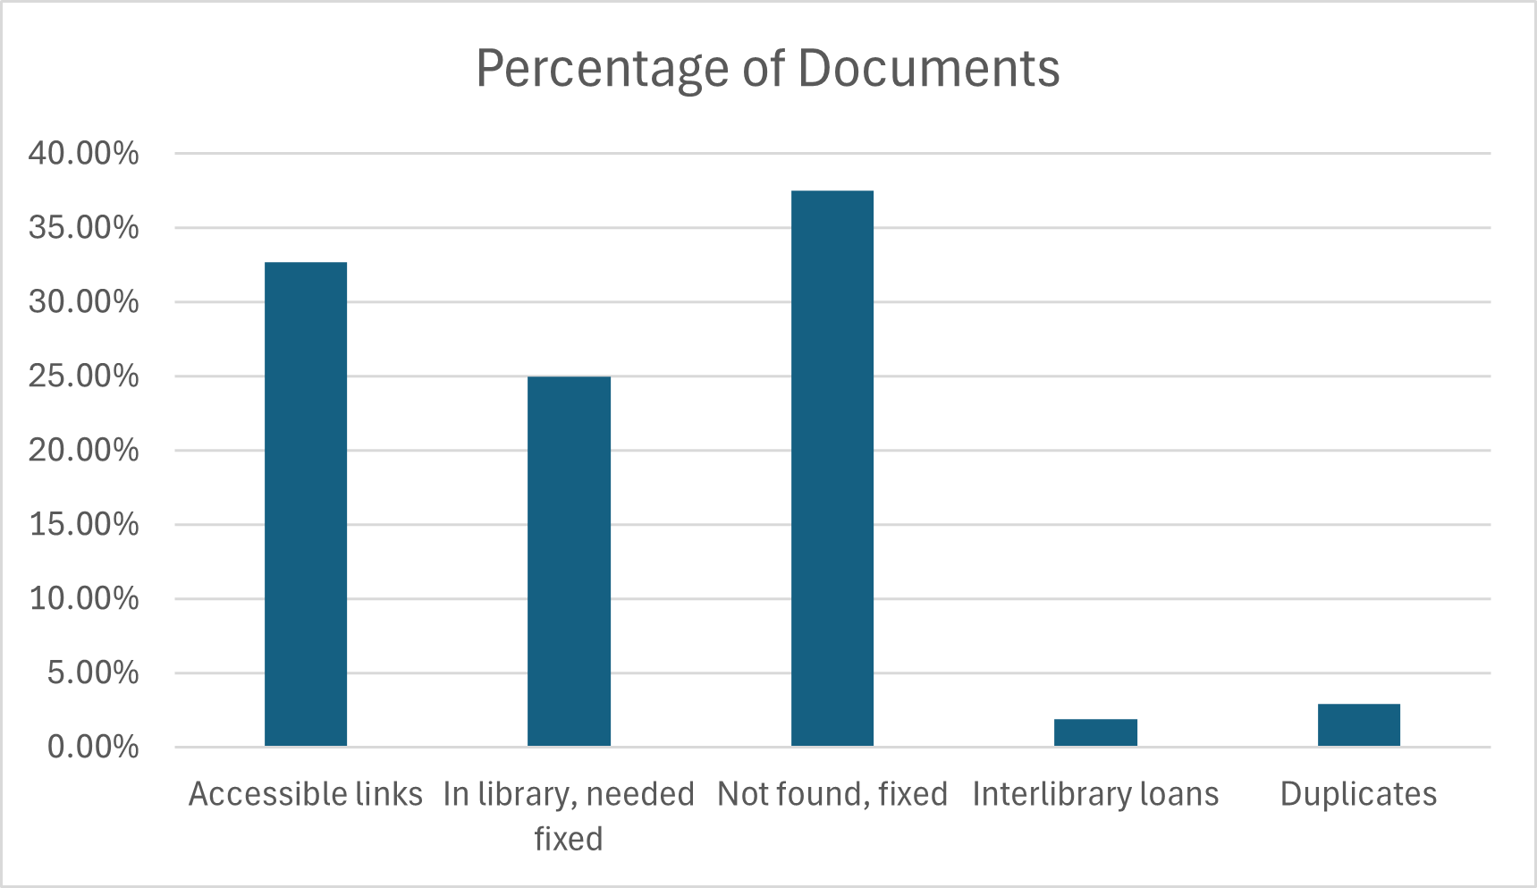
Results At A Glance
Total time spent: 218 hours
Total documents: 104
Accessible links: 34 (32.7%)
In library, needed fixed: 26 (25%)
Not found, fixed: 39 (37.5%)
Interlibrary loans: 2 (1.9%)
Duplicates: 3 (2.9%)

Slide 34
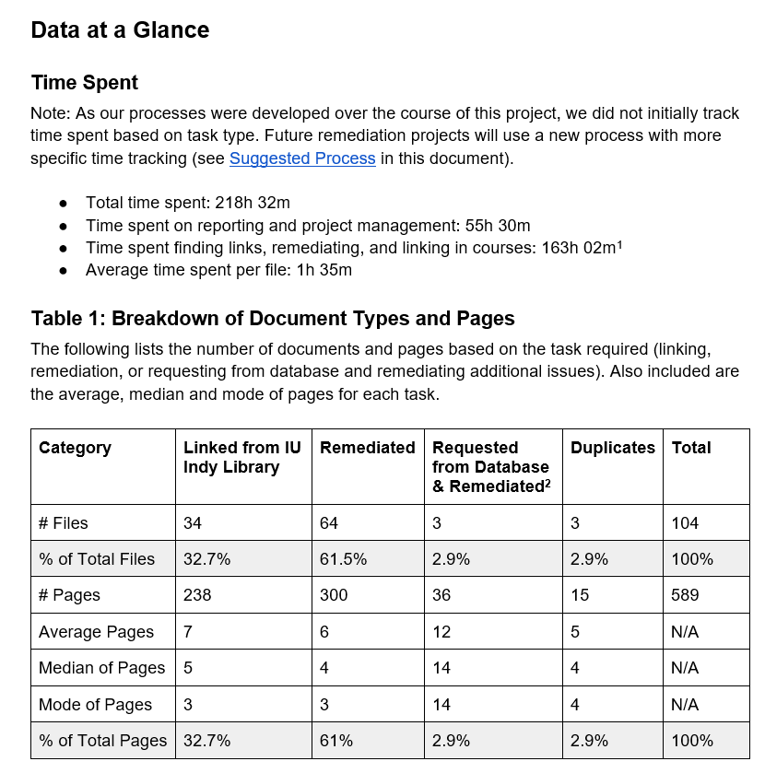
Project Deliverables
Our project report highlighted the effort involved and the barriers we faced to upper management.
Also created/updated:
PDF and Word guides
Flowchart for fixing documents
Library contact info and workflow for instructional designers

Slide 35
Reducing Barriers

Slide 36
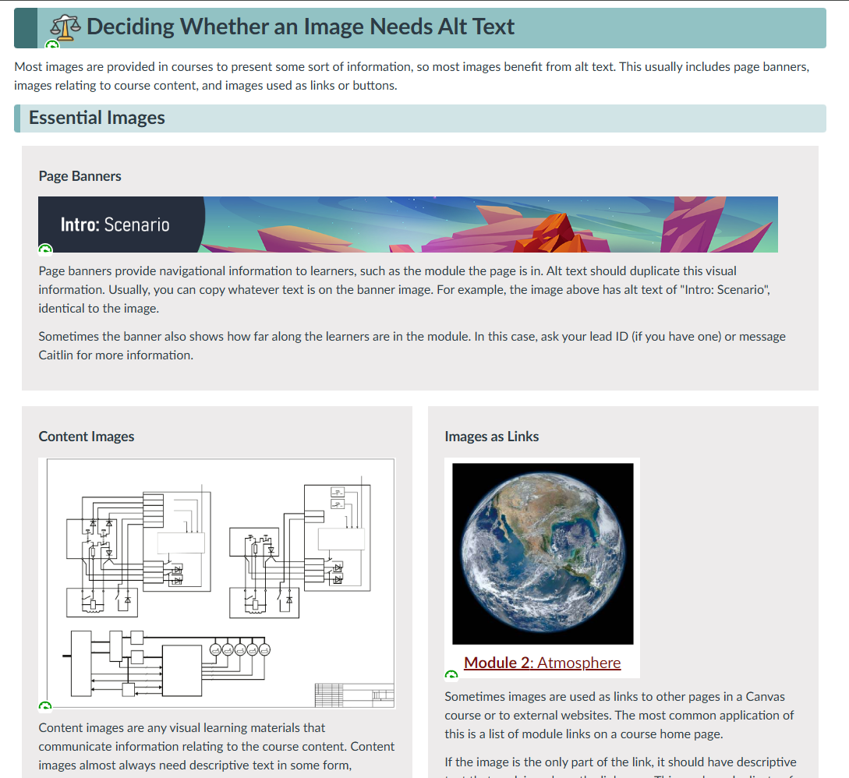
Training Materials
Plan for new learners.
Aim for self-contained topics – can be adapted/added to later.
Offer live sessions and recordings for those who can’t attend.
Short, step-by-step written guides work well (esp. with screenshots).

Slide 37
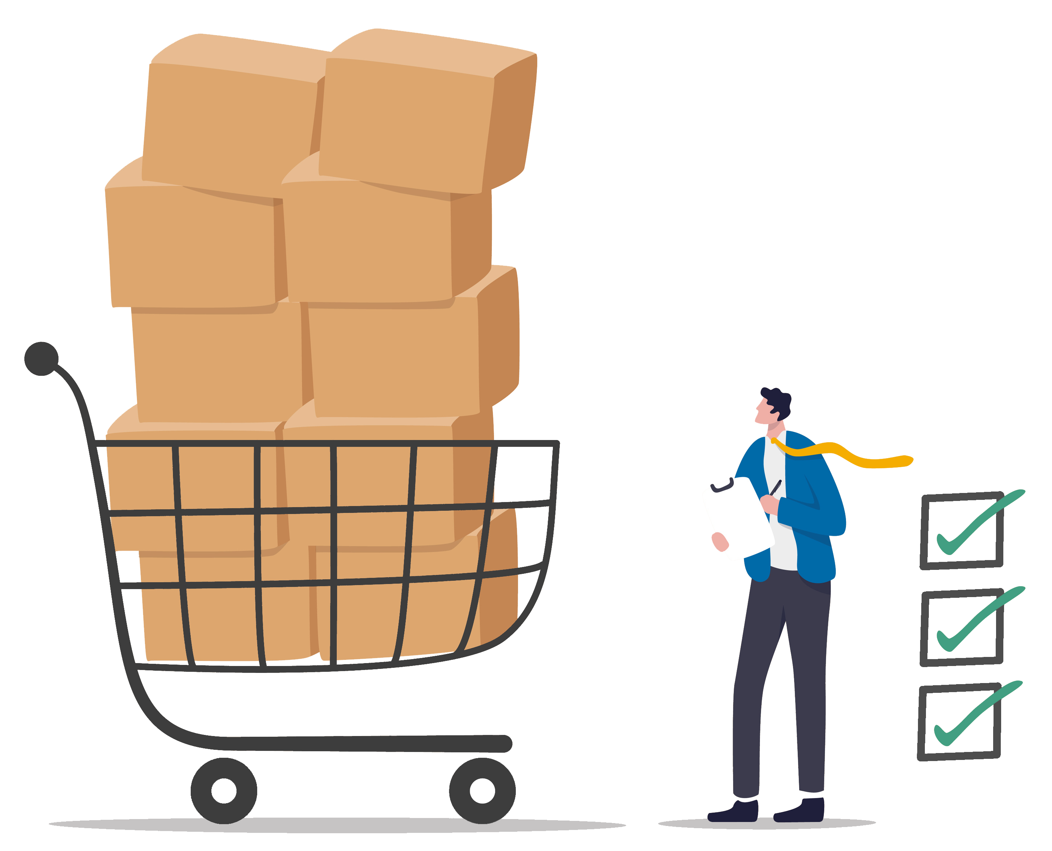
Advocacy & Procurement
Bring accessibility into the conversation.
Ask vendors about their tool accessibility and limitations.
If you can, choose new tools and databases that are accessible.
Look for workarounds, but also communicate barriers.
Look for opportunities to collect data on: file issues, hours spent, potential impact

Slide 38
Building Relationships
Libraries
Systems knowledge & vendor relationships
Accessibility Experts
Workflows & best practices
Instructional Designers
(TLT & Per Program)
Implement solutions & promote library resources
Teaching & Learning Technologies
Training & documentation

Slide 39
Tips for Building Relationships
Start small! Little steps matter.
Look for opportunities to save time, resources, energy for everyone.
Seek to understand each others’ perspectives and the overall system.
Notes:
Starting with a small project helps define everyone’s roles while also building trust.

Slide 40
Takeaways

Slide 41
Tips: Identifying Barriers
Look for testers: students, faculty, or other departments.
Identify choices: How do you make the decision? What would someone else need to know?
Core knowledge: What info is specific to the libraries that may need to be taught?
What questions are you asked the most?

Slide 42
Tips: Addressing Barriers
Can you fix it?
No
Can you add supports to it?
No
Train & document it
Yes
Yes
Yes
Choose more accessible tools
Promote accessible databases
Live sessions
Advocate to vendors for improved services
Use tools to fix or generate alt formats
Step-by-step text & video guides
Notes:
Image description:
Can you fix it?
Choose more accessible tools
Advocate for vendors to improve services
If not, can you add supports to it?
Identify & promote databases that are accessible
Use tools to fix/generate alt formats: Anthology Ally, MathPix, Pandoc
If not, can you train for/document it?
Step-by-step text & video guides
Live sessions

Slide 43
More Resources
Guides & Links
TLT’s Accessibility Guide
Word accessibility
PDF accessibility
Image alt text (WebAIM)
DIAGRAM center for complex images
Software
Anthology Ally
MathPix
Pandoc

Slide 44
Thank you! Q&A Time
Connect with me:
caimalon@iu.edu

