Slide 1
Streamlining Access: The Development and Implementation of the ACE Self-Declaration Form
Allison Ridgway and Ellen Olsen-Lynch, Trent University
OCUL Accessibility Symposium 2.0
Wednesday, June 18, 2025

Slide 2
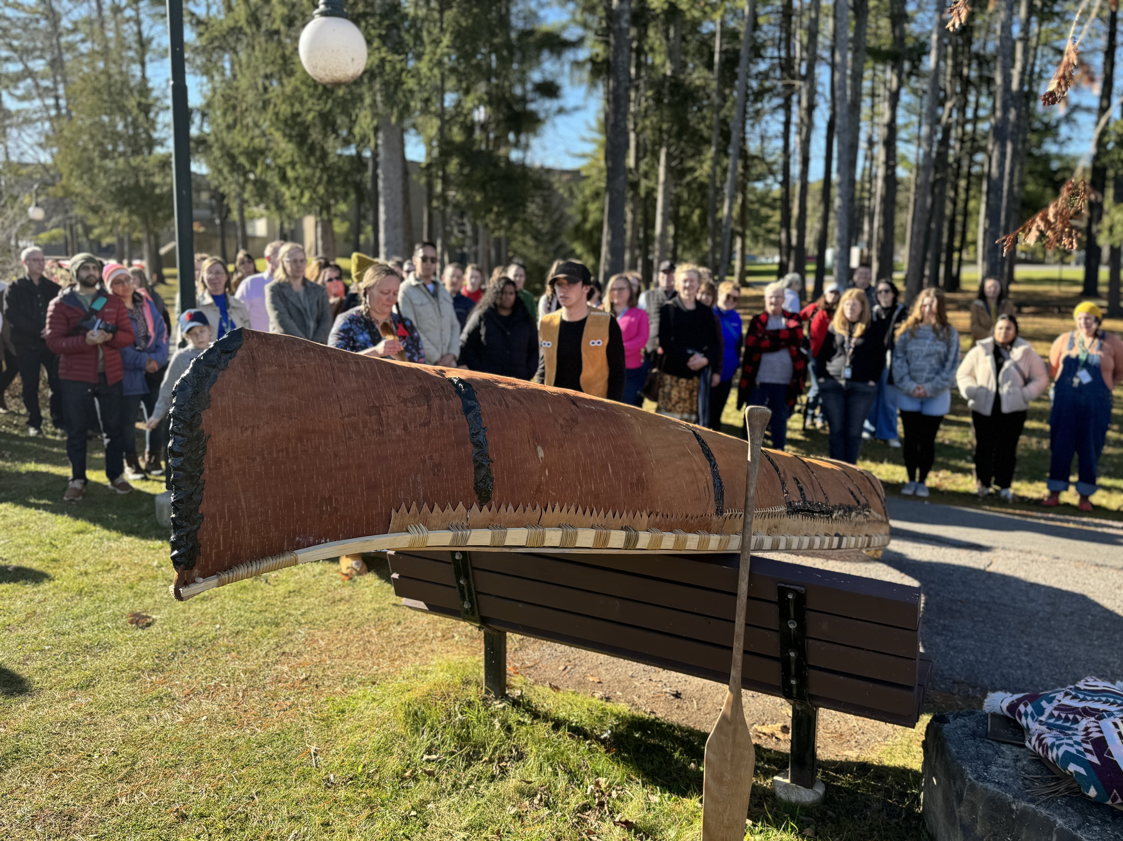
Land Acknowledgement
We respectfully acknowledge that we are on the treaty and traditional territory of the Mississauga Anishnaabeg.
We offer our gratitude to the First Nations for their care for, and teachings about, our earth and our relations.
May we honour those teachings.
A photo of the birthing ceremony for the traditional birch bark canoe, Enheh, which was built in Bata Library by Alex Labelle, a traditional canoe builder who is Métis of Algonquin ancestry. - Photo by Clay Pearn

Slide 3
Agenda
Trent and ACE introduction
Rationale for ACE self-declaration form
Development and implementation
Promotion and next steps

Slide 4
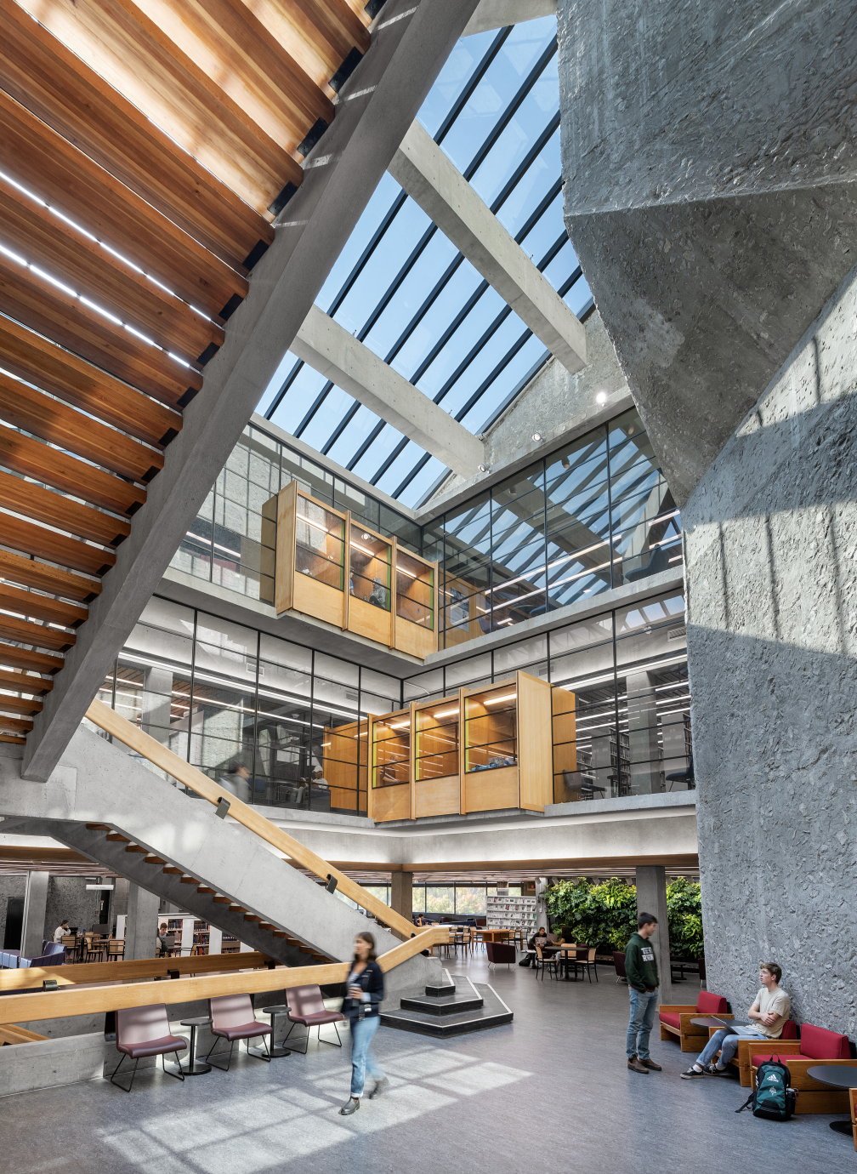
Trent University
Peterborough Campus (90 min northeast of Toronto)
9,930 undergraduate students
1,037 graduate students
Durham GTA Campus (Oshawa)
2,556 undergraduate students
245 graduate students
9 Librarians (UL; 6 permanent; 2 LTA)
1 Archivist
20 Technical Staff
2 Managers

Slide 5
Library & Accessibility
ACE Coordinator (a librarian) in place since 2014
In 2023, Allison Ridgway participated in the ACE Assessment project
No in-house digitization and remediation service for accessibility
Until 2024, no librarian portfolio formally included accessibility
Most accessibility supports coordinated by library or departmental committees

Slide 6
What is ACE?
The Accessible Content E-Portal (ACE) is a service that was established in 2012 by Scholars Portal in Ontario which provides library materials in accessible formats in the following alternate formats:
Colour PDF
Black & white PDF
DAISY
EPub
Plain text

Slide 7
Who has access to ACE?
Students, faculty, instructors, staff at any participating ACE institution who hold an ACE token.
ACE Participating institution = OCUL Universities and Ontario Colleges.
ACE token = unique alphanumeric code, allows for almost complete privacy
ACE token holder = person who has requested a token based on a perceptual disability, which in Canadian copyright law, includes a disability that affects a person's ability to read or see literary works (such as books or articles) in their original print (physical) format. This includes:
severe or total impairment of sight or hearing or the inability to focus or move one’s eyes,
the inability to hold or manipulate a book, or
an impairment relating to comprehension.

Slide 8
What can be digitized for ACE?
Print monographs owned by participating ACE institution libraries, except for:
Coursepacks.
Personal/Instructor copies i.e., must be owned by a Library.
Rare, delicate, or other special books which cannot be loaned.
Library or archival materials that are not books, e.g., journal issues.
Generally, ACE does not have textbooks since they quickly become outdated and AERO (Alternate Education Resources Ontario, Ontario Ministry of Education) provides some support for this type of material.
No restrictions on subject matter.

Slide 9
ACE Digitization Request Process at Trent
Student requests token (or instructor or staff member) via e-mail or in-person to either the Library or Student Accessibility Services. There are now two ways to acquire a token:
Student Accessibility Services (SAS) (encouraged route to bring awareness to other SAS supports) – student required to schedule appointment and supply documentation.
Self-declaration form ***NEW***
Student submits digitization request to Library (directly or via SAS).
ACE Coordinator submits digitization request to ACE via online form.
ACE processes request (at Robarts Library at University of Toronto).
Borrows book from participating institution or retrieves from the Internet Archive.
If Trent is the only holding institution, we send the book to ACE.Must be owned – i.e., can’t be a personal copy. On few occasions, we have needed to purchase a print copy to send to ACE.
ACE Coordinator notified when request completed (usually 1 – 3 weeks), who then notifies requestor.

Slide 10
ACE Use at Trent
Ace Downloads by Year
 | 2023 | 2022 | 2021
Trent | 35 | 19 | 4
U of T | 906 | 1196 | 1103
OCUL | 2217 | 2509 | 2217
Data sourced from the Scholars Portal Dashboard 2023

Slide 11
Ace Use at Trent (continued)
ACE Digitization Requests by Year
 | 2023 | 2022 | 2021
Trent | 20 | 10 | 1
U of T | 334 | 274 | 224
OCUL | 1053 | 571 | 364
Data sourced from the Scholars Portal Dashboard 2023

Slide 12
Rationale/Motivations
ACE Assessment Report
Barriers to access
Users need quick access to course readings, but Student Accessibility Services (SAS) appointments fill-up quickly, leading to delays
Streamline access by allowing users to receive token at same time they request digitization
Some reported hesitancy to book appointment with SAS or don't know they're eligible
Library can start students on the ACE access process if they identify in a research consultation that it's needed
Support for faculty
No identified avenue for eligible faculty to easily/quickly receive ACE token
Equity and Human Rights Office (EHRO) don't provide tokens
Can work with EHRO and HR to ensure eligible users are given access as soon as needed

Slide 13
Development & Implementation – Step 1
Environmental scan of OCUL members
Determine if any members use self-declaration forms to provide ACE tokens & who is responsible for the form (library / accessibility services / other)
At time of scan (2023), most institutions required students to receive ACE token through accessibility services
University of Guelph has a "Perceptual Disability Self-Declaration and Alternative-Format Usage Agreement" as part of alternate-format request form
Sheridan College has AODA/ACE Self-Declaration Form
Other library websites mention self-declaration form is available but do not share it online

Slide 14
Development & Implementation – Step 2 and 3
2. Partnership with Student Accessibility Services
Initial fact-finding: how many registered, paths for users to access ACE, strengths & weaknesses of these paths
Further support for users on how to search & access content in ACE
3. Development of the Self-Declaration Form
Consultations with IT Services about user data protection
Development in Microsoft Forms

Slide 15
Development & Implementation – Step 4
4. Developing an Information Security Plan (ISP) with IT for data storage
Form collects highly sensitive information (including users' names, emails, token numbers, self-declaration checkbox; no medical information or diagnoses are collected)
Work with IT and SAS to determine which staff have access to form & info spreadsheets
Develop form in Microsoft Forms / Office 365
Only users with a @trentu.ca email can access
Ensure user anonymity as much as possible
Archive necessary data in secure institutional repository (using Microsoft Excel) & provide access to 3 librarians & 1 SAS staff member

Slide 16
Development & Implementation – Step 5
5. Staff Training
Student Accessibility Services invited to give workshop on accessibility at All-Personnel meeting
Librarian delivered training to Service Desk staff on what ACE is, why self-declaration form created & how to support users with accessing & filling out form

Slide 17
Form components - preamble
If you encounter a barrier to completing this form, and/or you need an alternate format of this form, please contact us by email (library@trentu.ca). Trent University Library & Archives works with ACE to provide alternate formats of print materials to readers with perceptual disabilities, as described under Canadian Copyright Act (R.S.C., 1985, c. C-42). This form is for currently-enrolled students and employees at Trent University who:
do not currently have an ACE token;
are not currently registered with Student Accessibility Services at Trent University;
have a perceptual disability (as defined under Canadian Copyright Law, described below)
require library materials in accessible or alternate formats.
Please do not fill-out and submit this form if you already have an ACE token. If you have received an ACE token from Student Accessibility Services or the Library and it is not working, or you have other questions or concerns regarding ACE, please email library@trentu.ca.

Slide 18
Form components – preamble (cont'd)
Privacy and Confidentiality
Trent University Library & Archives protects users’ privacy and personal information. In accordance with current privacy legislation, departments at Trent collect only personal information that is necessary to operate their programs, services and activities. Access to user information collected through this form is limited to employees of Trent University Library & Archives and Trent’s Student Accessibility Services who are responsible for distributing ACE tokens. All records, whether in electronic or hard copy, are retained in accordance with the University’s Access to Information and Protection of Privacy Policy and maintained in a secure environment.

Slide 19
Form components - questions
Your name (First name and last name)
Trent University email
At which Trent University campus are you located? (Peterborough, Durham)
What is your current academic status at Trent University? (undergraduate, graduate, faculty member of instructor, staff member, other)
Student number or staff number
By completing this form, I am agreeing with the following statement (I agree, I do not agree): I am a person with a perceptual disability as defined by the Canadian Copyright Act:
a severe or total impairment of sight or hearing or the inability to focus or move one’s eyes;
the inability to hold or manipulate a book;
an impairment relating to comprehension.

Slide 20
Form components – questions (cont'd)
By completing this form, I am agreeing with the following statement. (I agree, I do not agree):
The alternative format materials I access through ACE are for my personal use only. I will not copy, share, or redistribute these materials.
I understand that Trent University reserves the right to ask for verification from a competent authority at any time. (I agree, I do not agree)
I understand that Trent University Library & Archives reserves the right to deny service to an individual who knowingly provides incorrect information on this form or who does not follow the usage requirements stated above and further. (I agree, I do not agree)
Please sign (type) your name below:

Slide 21
Promotion
Library Website
IL Workshops & Library Outreach Events
Departmental Meetings, Newsletter & Communications with Faculty
Library Accessibility Info Card

Slide 22
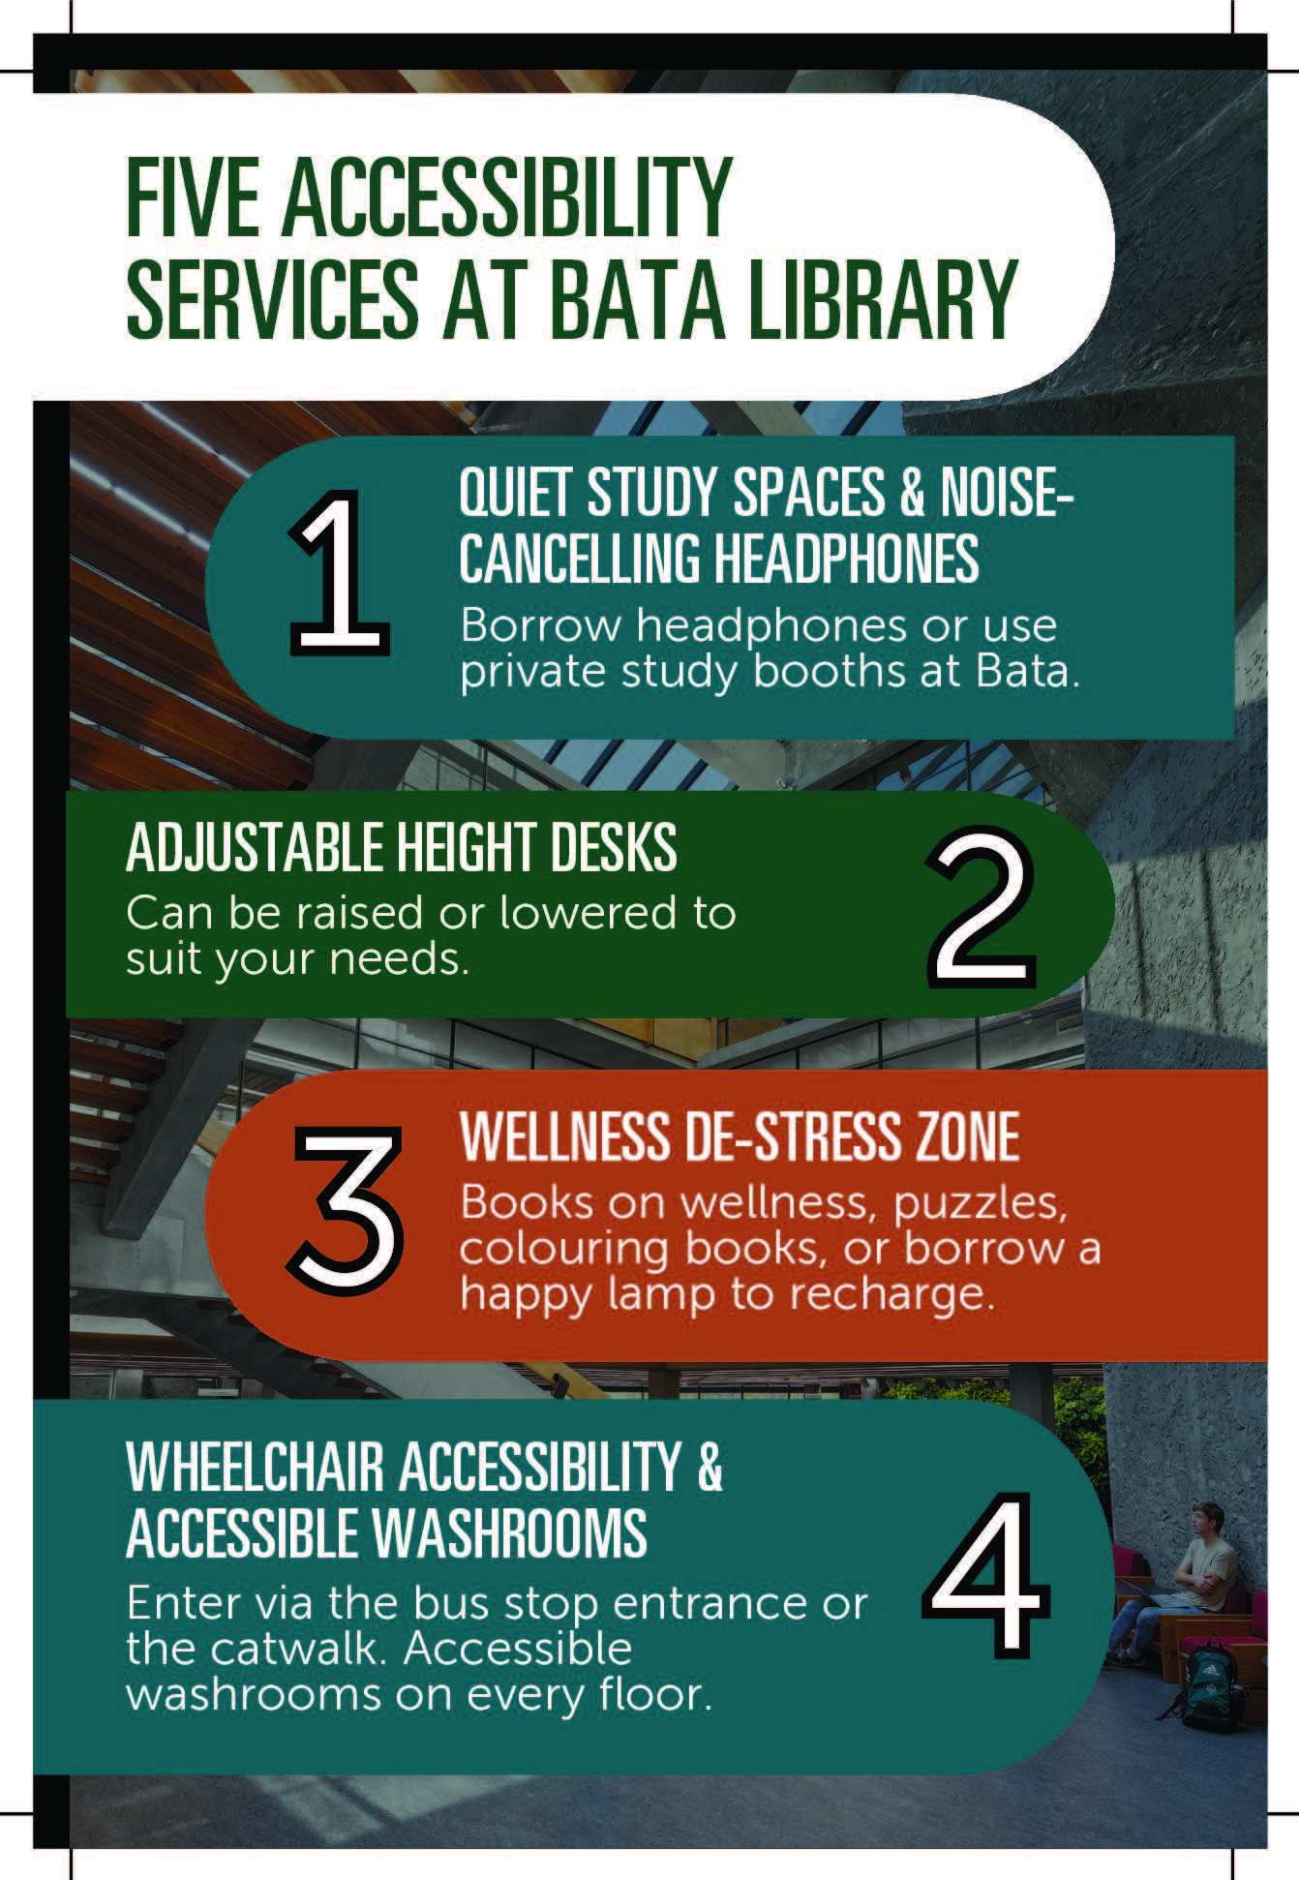
Accessibility Info Card

Slide 23
Next steps
Further Promotion
Evaluation
Integrating Digitization Requests with Omni
Outreach Events Focused on Accessible Formats & Accessibility Topics

Slide 24
QUESTIONS???

