Slide 1
Accessible (Digital) Archives: Why we don't have them and why AI isn't helping
(sensationalist title explained: AI is helping, but only with certain aspects of digital archives workflows, leaving critical areas of accessibility unchanged and greatly in need of improvement)
Mark Pellegrino
Digitization Services Librarian
McMaster University
October, 2024

Slide 2
Sample Starting Image
Twelfth page of the Monstrorum historia
By Ulyssis Aldrovandi, 1642.
1 of 956 pages.
Latin language, hand-written, blackletter font.
Digitized as 600dpi TIFF image, 62.2 MB.
Very tough situation for OCR
Drawn adornments around image.
Decorative drop cap (starting letter).
Supporting text in margins.
Single letters around paragraph (G,H, A, DE).

Slide 3
OCR and hOCR (HTML Optical Character Recognition)
Recognize the characters in the image.
Overlay those digital character over the images of those character using a coordinate system called hOCR and embed it in your PDF.
Predict the font in the image as a TTF and embed it in your PDF.

Slide 4
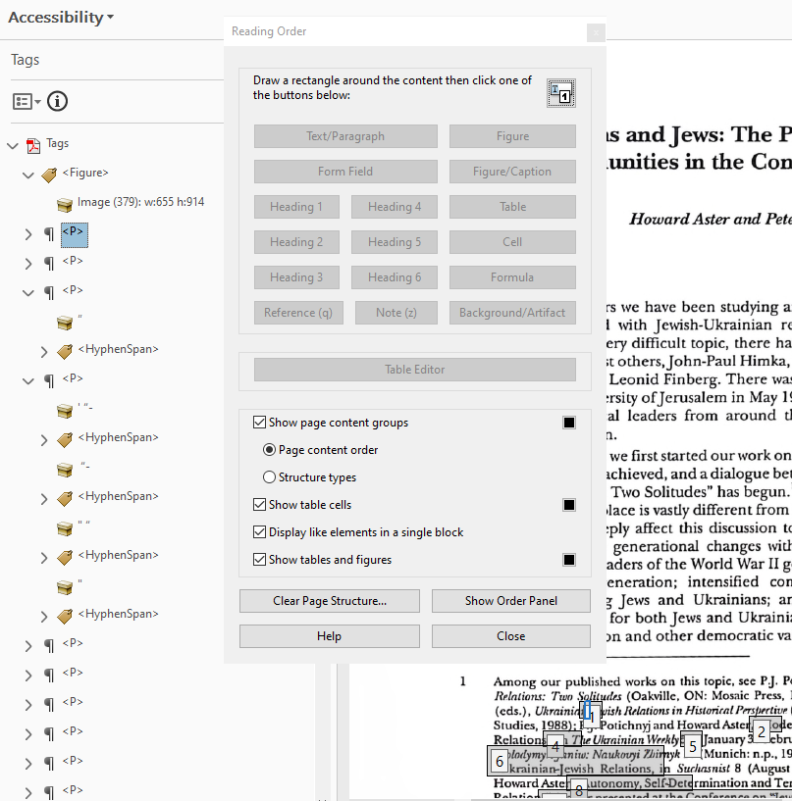
Accessibility Tools: Adobe Acrobat
Why PDF? It's a versatile, universally supported way to encapsulate and disseminate information.
Elements of an accessible PDF:
Tagging – PDF elements employ html tagging just like a website, with opportunities to support modern HTML5 semantic tagging.
Reading Order – tagged elements must be assigned to numerical order for assistive devices.
Text overlay – the invisible textual element on top of the source image.
Alt-text for describing images.
Embedded Metadata (title, author, subject, etc).
If you're interested, check out The Accessibility Guy on YouTube

Slide 5
Accessibility Tools: Abbyy OCR Editor
Text editing, verification, and correction tool for optical character recognition.
Left side: Image with recognition areas (green for text, red for image)
Right side: OCR output for manual correction and verification.
Abbyy does not support accessibility features. You need Acrobat for that.

Slide 6
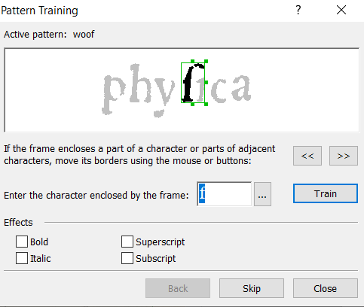
Using Abbyy's built-in Pattern Training
Create a unique character map, specific to this text.
Increases accuracy of recognition.
Struggles with ligatures and unconventional characters (like the long-s)

Slide 7
AI OCR Options:
None of these will interface with our Abbyy and Acrobat system.
Corporate OCR Options
Highly accurate.
Only produces extracted text.
Can not produce PDFs or add accessibility features.
Privacy concerns.
Free, Open-Source Option
Can create PDF with OCR overlay and hOCR coordinates.
Runs locally, with private training data = no privacy issues.
Can create and share you own training data.
VS

Slide 8
Tesseract OCR Output vs Source Image
VNCTORV M inuulgatis animantium moribus, & nai
lits0 turis, phyſica miracula nomine monſtrorum vulgoò nuncu-
V 7lll l pata, in aſpectum publicum modò producenda ſuccedunt;
V 7ẽã7 3à5 qus aliquando contingere, explorata fatetur veritas, & potiſſimim
quandon,on iuxta conſuetam naturæ normam, pere
grina quædam, vel toti generatorum corpori, vel eiuſdẽ
partibus(ſiuẽ de homine, ſiuẽ de brutis, ſiuẽ de plantis ver- Moniſtra at
ba fiant)figura, vel character imprimitur. Non enimhæc tinent aaà a-
-——" authorum ſunt deliria, vel ſomnia, qui fucata perſuaſione, nimalia, &
Notes:
The ae ligature is part of the normal unicode character map?

Slide 9
Chat GPT OCR Output vs Source Image
CVNCTORVM inualgatis animantium moribus, & naturis, physica miracula nomine monſtrorum vulgò nuncupata, in aſpectum publicum modo producenda ſuccedunt: quae aliquando contingere, explorata facituer veritas, & poſtissimum quando, non iuxta conſuetam naturæ normam, petitur regina quædam vel toti generatorum corpori, vel eiusdem partibus (ſiue de homine, ſiue de brutis, ſiue de plantis verſa­batur figura), vel character imprimuit. Non enim hæc authorum tantum deliria, vel ſomnia, quæ ſui carent periculo,
Notes:
The ae ligature is part of the normal unicode character map?

Slide 10
Using AI generated extracted text in a PDF
Why not just copy and paste it into your OCR Editor?
Sadly, it doesn't work like that. It makes for really sloppy PDFs.
There's no way to generate the hOCR coordinates with extracted text.
Text won't match the source image.
Searches may not work.
Won't be able to highlight and copy + paste the correct words.

Slide 11
Using Tesseract with Training Data from https://latinocr.org/
pdf – Create PDF containing compressed version of original image with hidden, searchable, and selectable textual overlay.
txt – extracted text in plain text .txt file.
hocr – extracted text as xhtml character position information in .html file

Slide 12
PDF textual overlay compared to extracted text

Slide 13
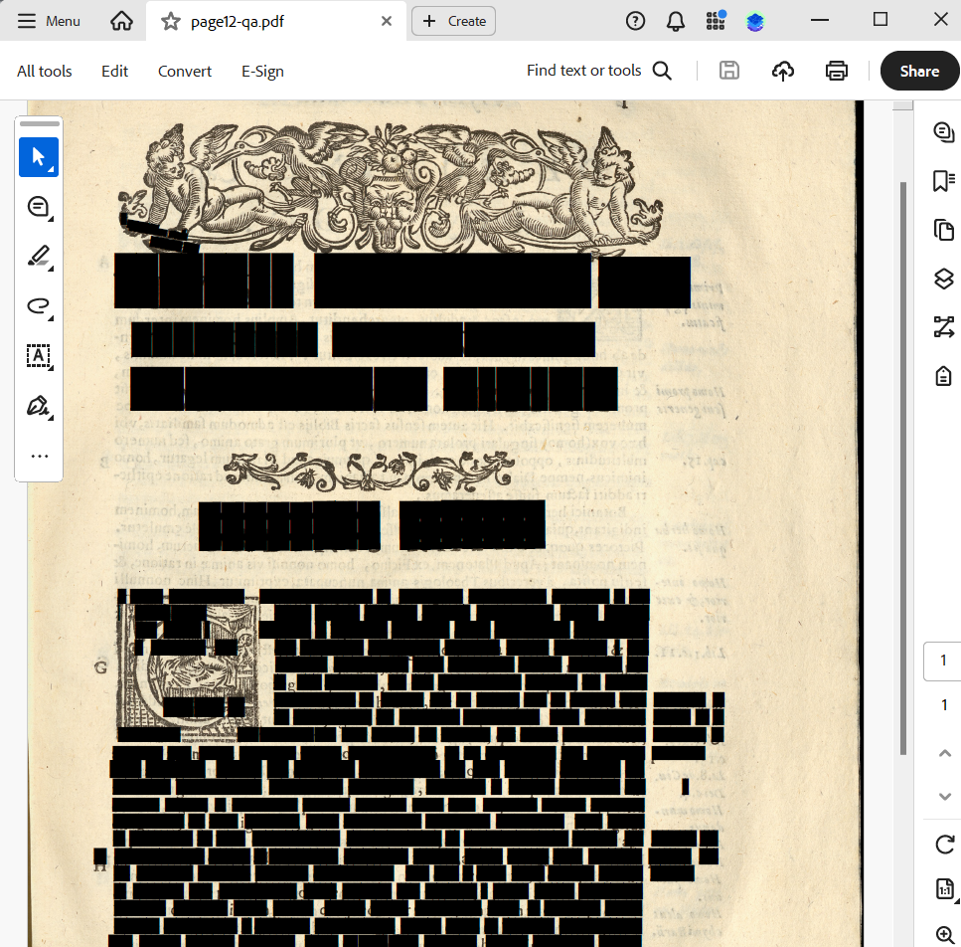
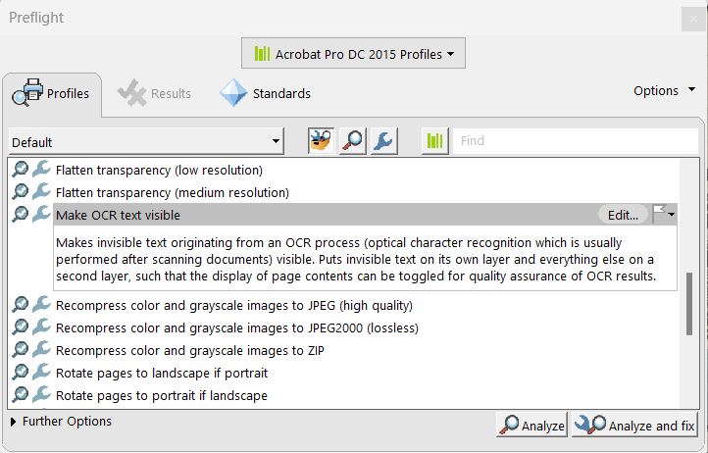
Editing Tesseract PDFs in Acrobat
Tesseract embeds a 'Glyphless' font when creating a PDF.
PDF editing or verification tools cannot open or understand this font.
Acrobat displays text as blacked out.
Abbyy will not open PDFs created with Tesseract.

Slide 14
Homegrown Solutions - ScribeOCR
One of the only hOCR editing tools.
Completely web-based.
Accepts image + corresponding hOCR files from Tesseract.
Has limitations:
Single developer.
Does not support special characters like the long-s.
Exports can be slow.

Slide 15
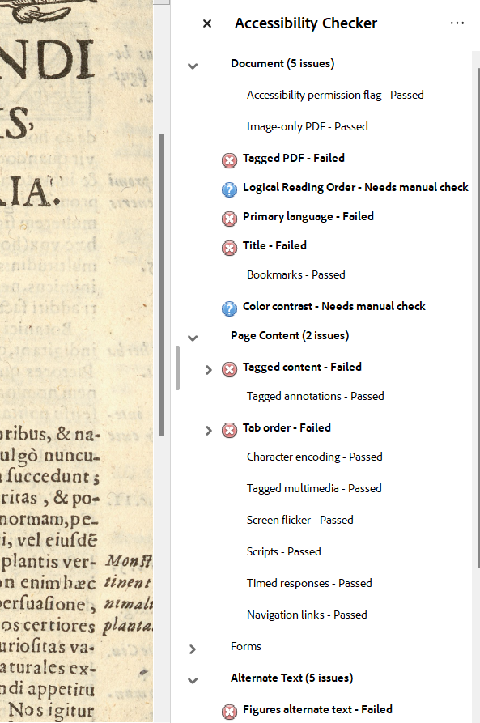
So, what do we do?
Meeting PDF accessibility requirements is very laborious.
Accessibility requests can take too long to fulfill.
Accessibility software has little development and hasn't advanced in years.
This is all reliant on Adobe to further develop PDF accessibility features that are sparsely used.
We don't have to use PDF. Web-based systems like the IA Reader are surpassing PDF for accessibility, with support for multiple download formats, various views, and built-in screen readers.
HathiTrust avoids this by providing a text version of documents, but not as a PDF text overlay.
Students will likely be able to use tools themselves to improve their own accessibility experience.

Slide 16
Using ChatGPT for Accessibility Support
Students and researchers are probably just going to do it themselves with ChatGPT.
ChatGTP can translate languages, create summaries, or generate transcriptions in just a few seconds.
It's an easy to use, user-facing experience (with obvious environmental and ethical concerns).
Doesn't mean that we don't still have an obligation to distribute content without meeting accessibility guidelines.

Slide 17
Thanks, Let's talk.
Mark Pellegrino
Reach me at: pellem11@mcmaster.ca
Some great sources if you're interested:
The Accessibility Guy on Youtube
Internet Archve PDF workflows
Investigating OCR and Text PDFs from Digital Collections. Jonathan Rockhind, 2023
ScribeOCR
Latin OCR
Tesseract GitHub thread about Glyphless fonts.
Tesseract Google Group
hOCR Standard

