Slide 1
Integrating Accessibility Into Database Procurement Processes
Rebecca Oling, SUNY Purchase
Carli Spina, SUNY FIT

Slide 2
Initial Goals
Evaluate e-resources
Build community
Develop accessibility skills
Create a generalizable process
Document & share best practices
Share with the wider SUNY-community

Slide 3
Cohort Structure
Assembled A SUNY-Wide Team
Structured Training
Developed Testing Process
Paired Testing
Local Testing

Slide 4
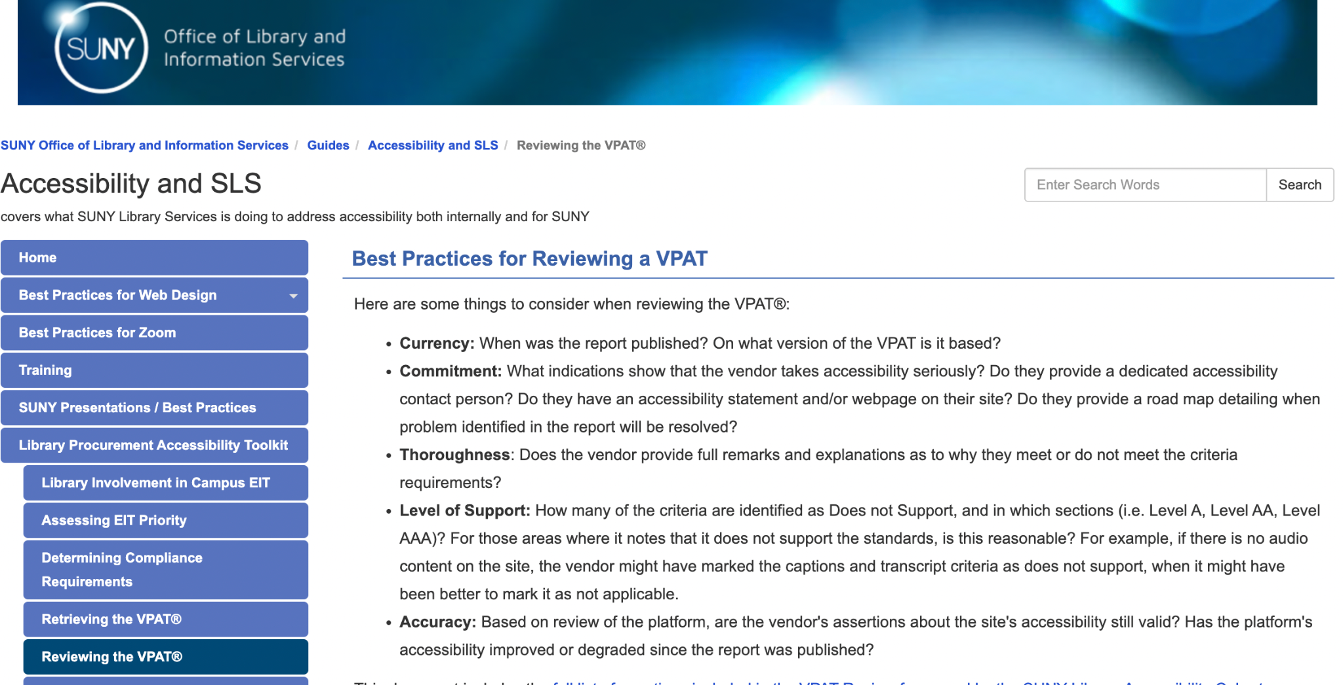
Library Procurement Toolkit

Slide 5
VPAT Review Process, Part I
Is the VPAT current and up-to-date?
Was it completed in-house or by a third party?
Does it demonstrate that the vendor takes accessibility seriously?
Are any comments or note thorough and clear?
What level of accessibility does it indicate the platform achieves?
At first review, does it appear accurate?

Slide 6
VPAT Review Process, Part II
Test for and evaluate alternative text
Check for and evaluate captions, transcripts, and audio descriptions
Test for assistive technology compatibility, including using a screen reader to navigate content
Evaluate color contrast
Test keyboard navigation
Check for flashing content

Slide 7
VPAT Review Process, Part II (cont.)
Evaluate the predictability of navigation and content layout
Test input assistance
Review compatibility with various tools and technologies

Slide 8
What Went Well?
Collaboration, community, confidence
Leveraging networks with the same goals
SUNY support was invaluable:
  Professional development (access to Deque University)
  SLS testing and reviews

Slide 9
What Could Be Better?
Baseline skills and understanding
Limited local support, particularly time
Some vendors still lag behind accessibility standards
Turnover (locally and in cohort)

Slide 10
Future Priorities
Compliance with New ADA Rules
Communicating Best Practices Across SUNY
Expanding Training Opportunities

Slide 11
Recommendations
Create a supportive environment
Support using multiple tools and methods
Balance structure with flexibility
Limit load
Build in time for confidence building
Document your work and share it widely

Slide 12
Thank you!
Rebecca Albrecht Oling Rebecca.Oling@Purchase.edu
Carli Spina Carli_Spina@fitnyc.edu

