Slide 1
Beyond the Default: A Starter Kit for Implementing Database Accessibility Icons
Carling Spinney, Ask Us Reference Assistant
Angélique Roy, Health Sciences Librarian
June 2025

Slide 2
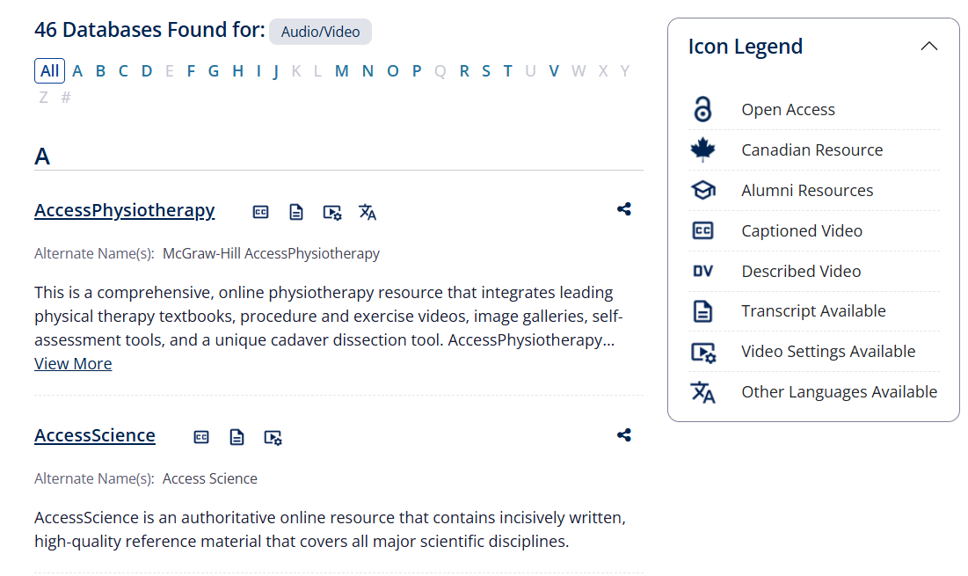
Outline
Background
Process
Pre-Implementation
Implementation
Future Directions
Starter Kit

Slide 3
Background
What led to this project

Slide 4
Queen's University Library: Strategic Priorities
Priority 4.2:
"We will assess the collection for the presence of and gaps in global perspectives and I-EDIAA. In 2023, we will identify two areas of representational focus and the priority collections on which a diversity audit will be performed in 2024. We will create and release an action plan to ensure sustained commitment to inclusive collections in 2025."

Slide 5
Priority 4.2: Global Perspectives and I-EDIAA
Group discussions about what diversity meant in library collections and numerous focus areas were discussed including disability and accessibility.
Decision to focus on accessibility functions of video databases to ensure all users can engage with library materials.
Accessibility means ensuring persons with disabilities have equal access
Improved discoverability of information resources on our website
Disability is experienced in diverse ways
physical or mental, temporary or ongoing, visible or invisible

Slide 6
Process
How we approached the project

Slide 7
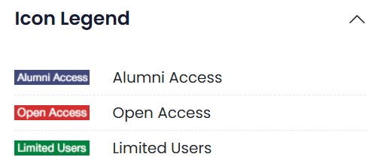
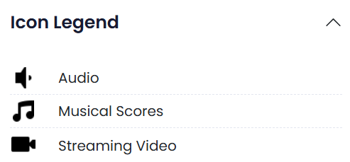
Step 1: Environmental Scan
Scanned the database icons of Collaborative Futures member institutions.
Video resource accessibility icons were not typically present.
A subgroup of 4 people reviewed video databases and determined the presence of accessibility functions with the goal of adding icons to the library's LibApps A-Z list.

Slide 8
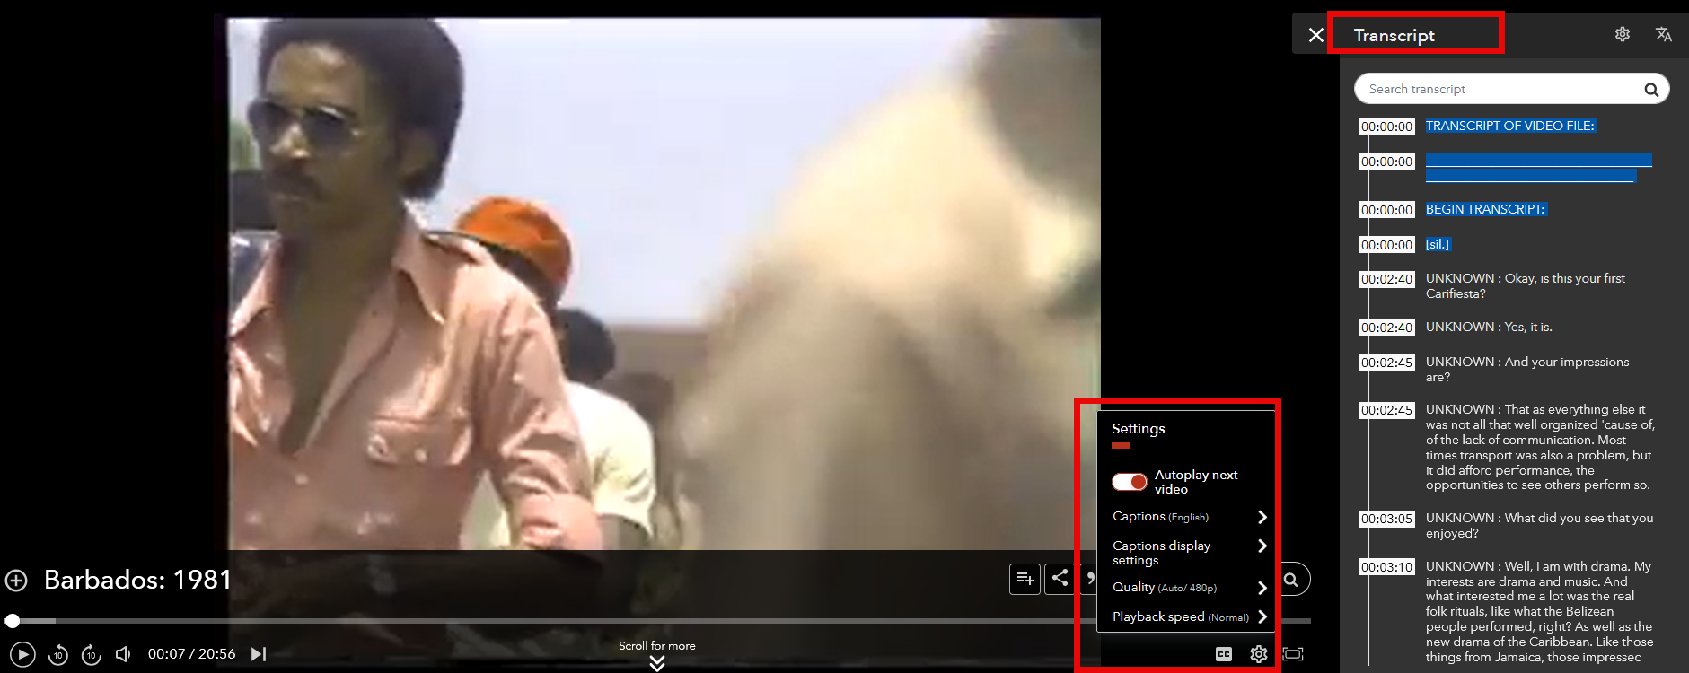
Step 2: Video Database Inventory (1)
Sample video with closed captions, a transcript and additional playback settings from the Carribean Studies in Video database

Slide 9
Step 2: Video Database Inventory (2)
Excel spreadsheet where inventory of databases and accessibility functions were documented

Slide 10
Step 3: Identifying Database Icons (1)
A subgroup of 2 people from the inventory data collection phase continued by brainstorming potential text-based custom flags or image-based icons to be added to database entries.
Text vs icons considerations:
Visibility
Recognizability
Positioning
Colour

Slide 11
Step 3: Identifying Database Icons (2)
Re-examined the list of 45 databases to identify which icons should be created and applied.
Determined 5 functions where icons would be added to multimedia databases moving forward:
Captioned Video
Other Languages Available
Transcripts Available
Described Video
Video Settings Available
"One or more" philosophy: Icons were applied to a database when at least one or more characteristics were present.

Slide 12
Step 3: Identifying Database Icons (3)
Column added to inventory spreadsheet to identify icons to be applied in the A-Z database list

Slide 13
Pre-Implementation
Collaborating with colleagues

Slide 14
Who was involved?
Web Development Team Lead
Metadata & Information Resource Management Technician
Metadata & Discovery Librarians x2
Selecting and adjusting icons
Uploading icon assets
Assigning icons to individual databases
Adding corresponding filters

Slide 15
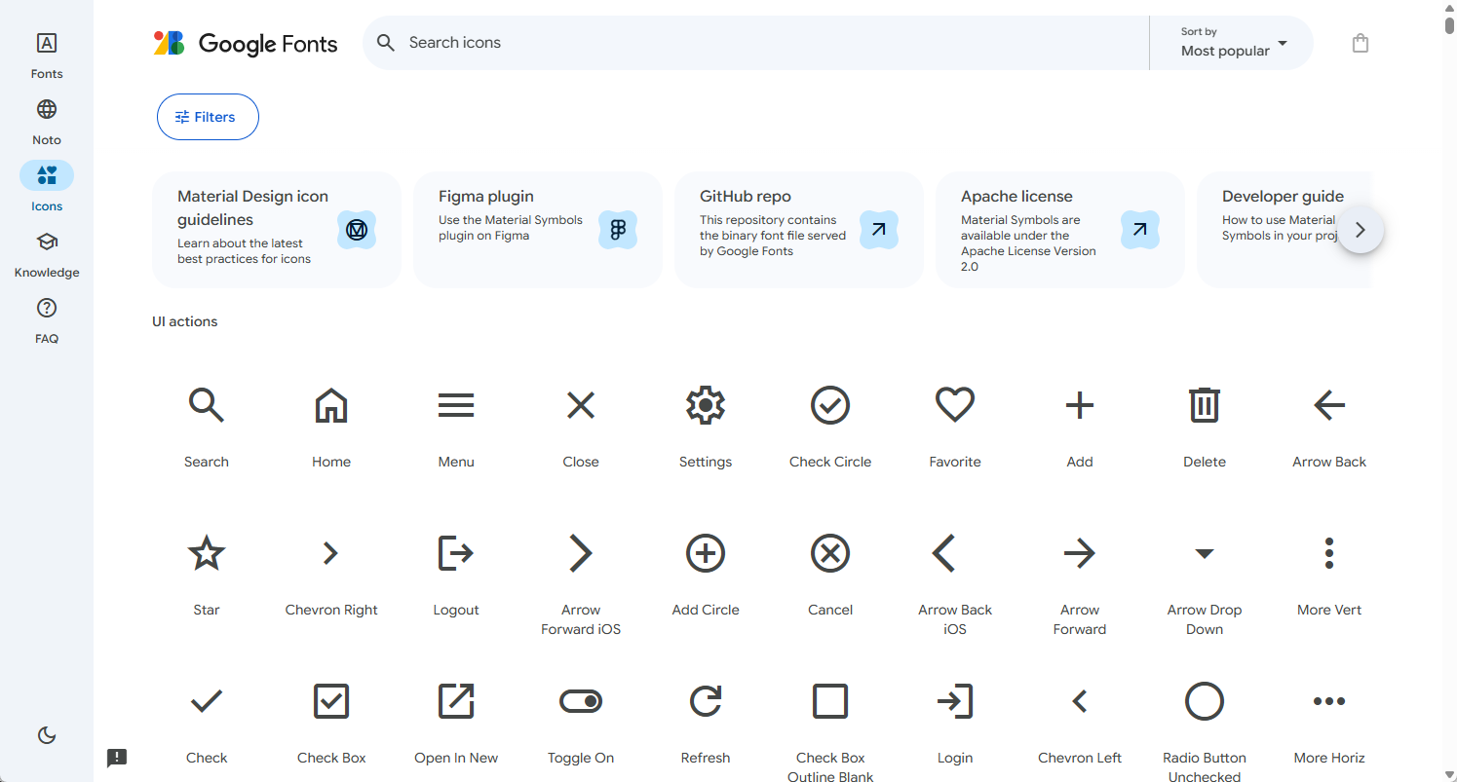
Google Fonts – Material Icons

Slide 16
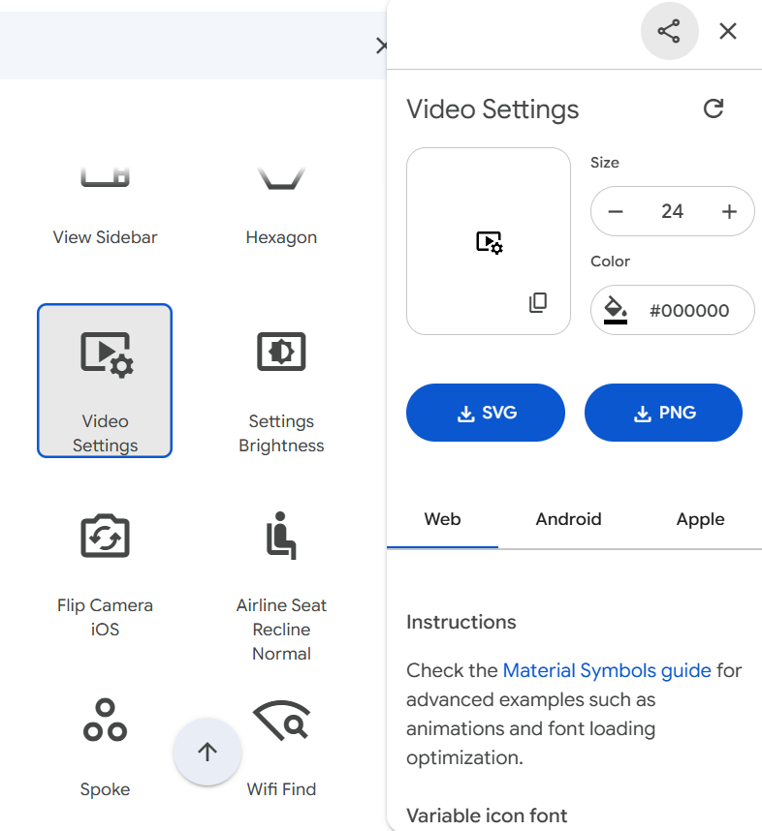
Selecting Our Icons
Described video
Captioned video
Other languages
Transcripts

Slide 17
Changing our Existing Icons

Slide 18
Implementation
The technical side

Slide 19
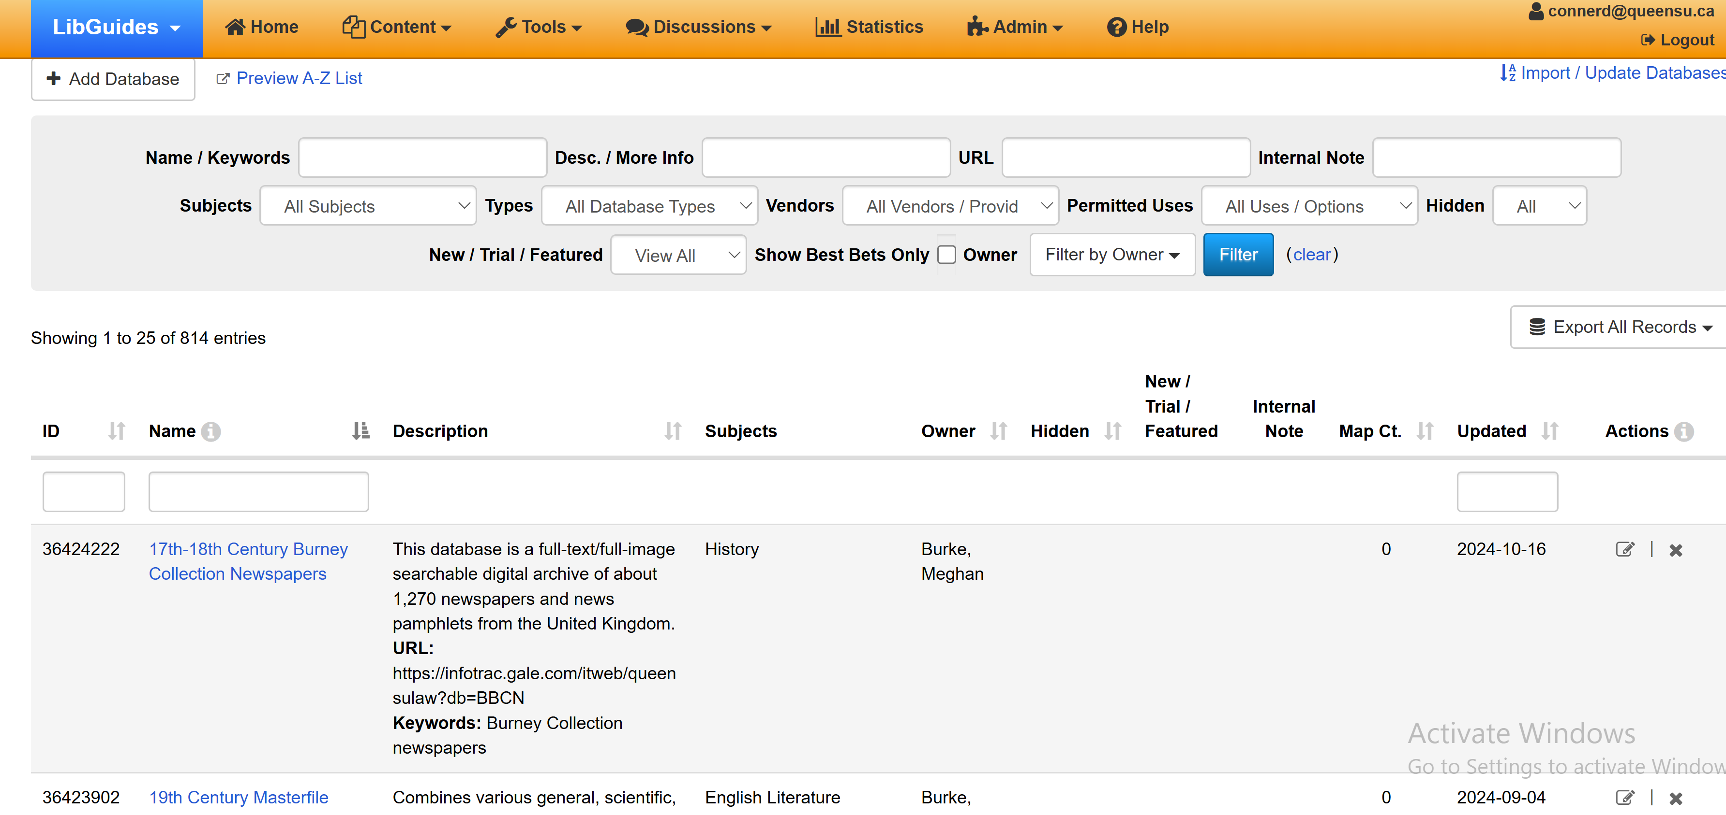
Adding the Icons (1)

Slide 20
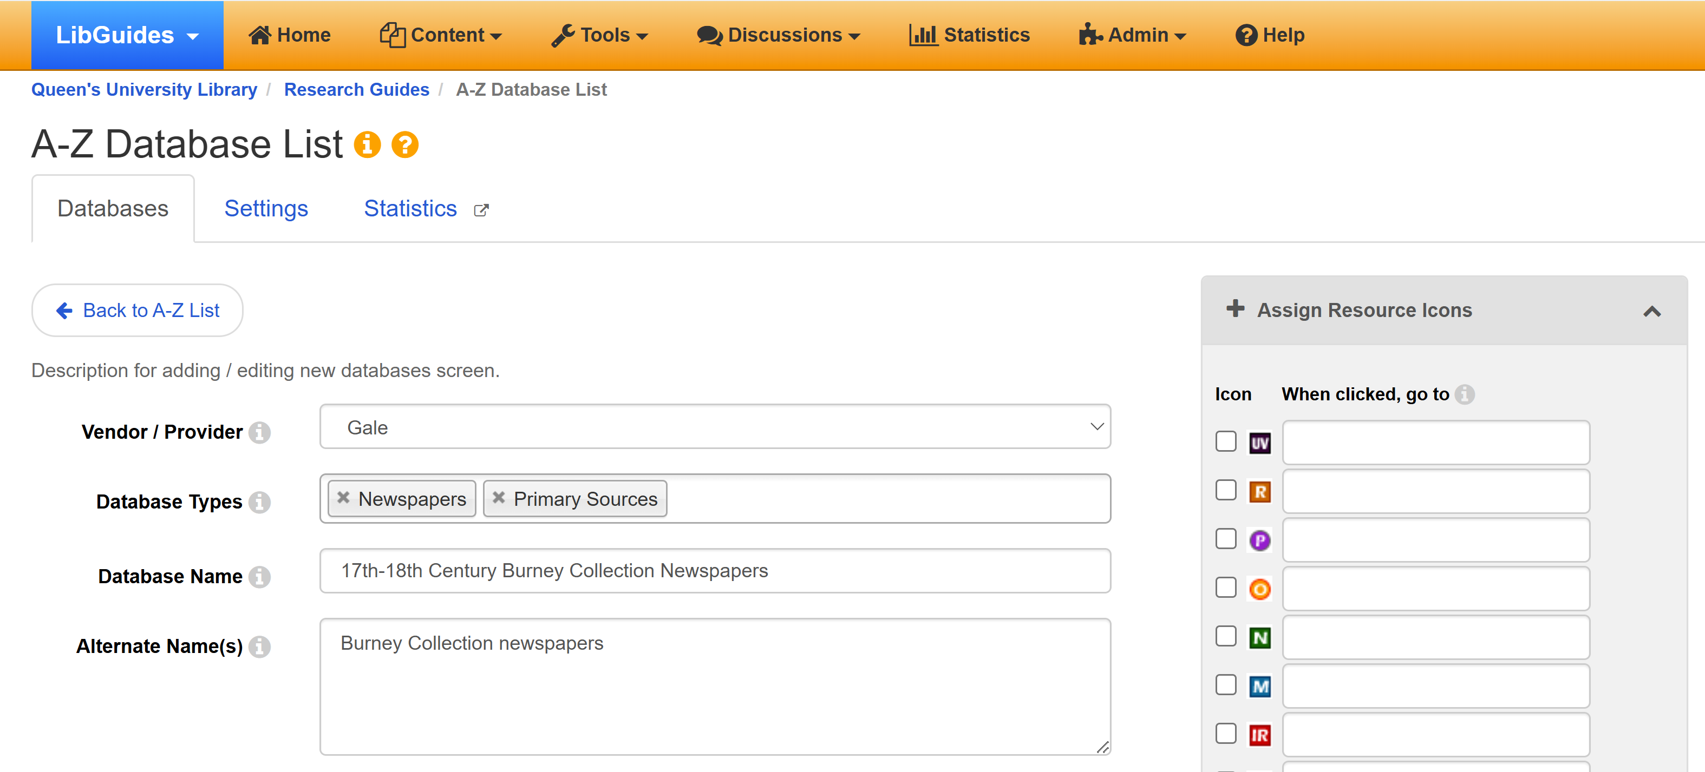
Adding the Icons (2)

Slide 21
Public Interface

Slide 22
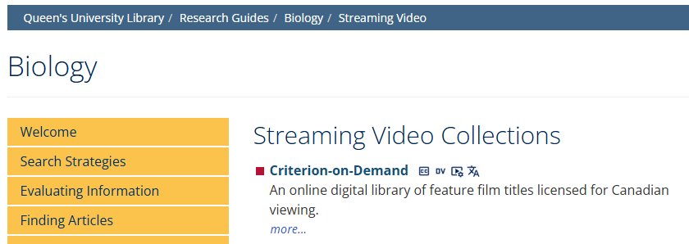
Icons in LibGuides

Slide 23
Future Directions
How we plan to build on this

Slide 24
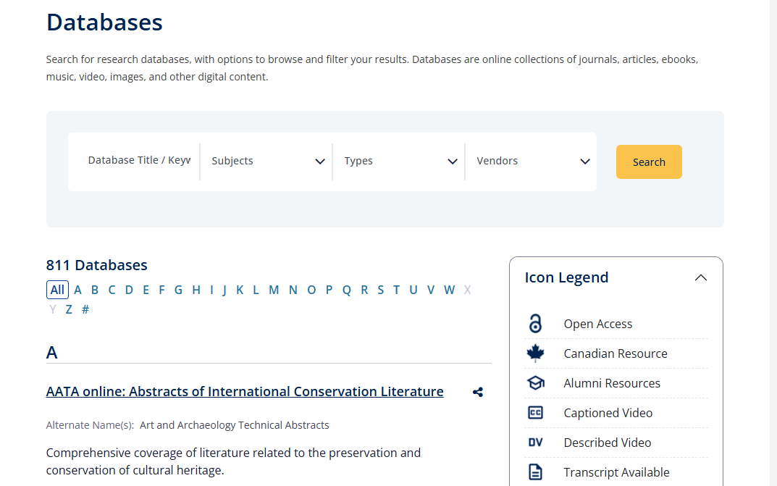
Adding Filters & Hyperlinks

Slide 25
Starter Kit
Check the conference website for resources!
Notes:
Explain resource guide

Slide 26
Thank You!
carling.spinney@queensu.ca
angelique.roy@queensu.ca

